Slide 1
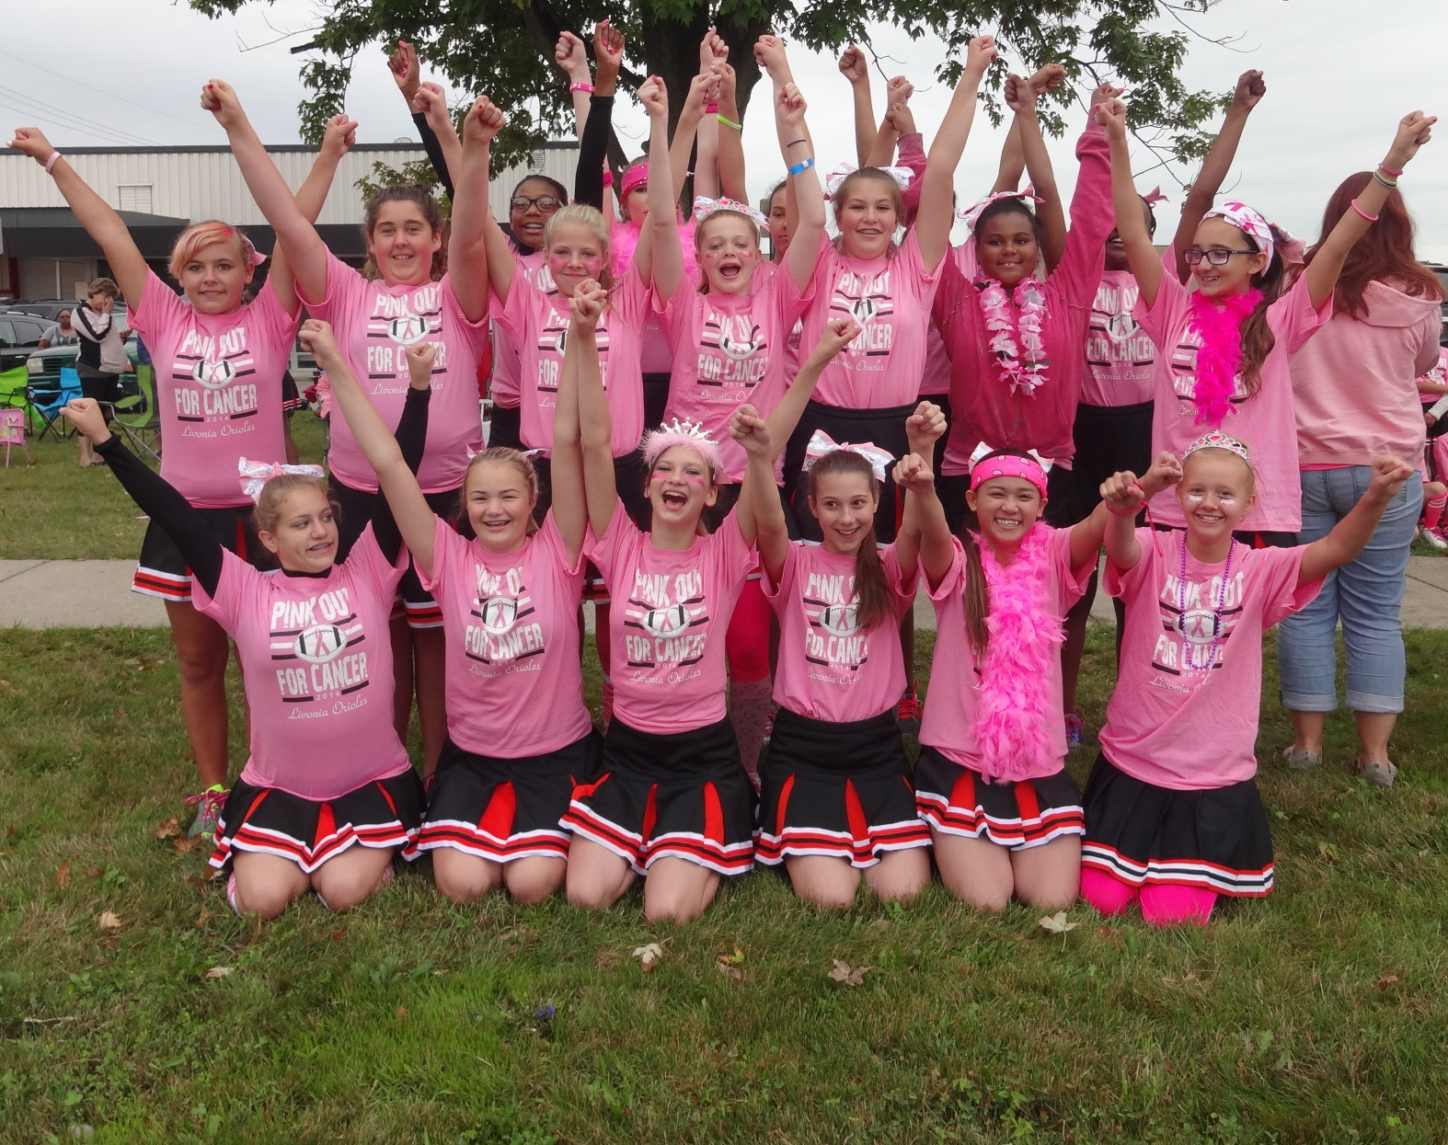
Livonia Orioles Cheer
2016 Parent’s Meeting
ORIOLES CHEER

Slide 2
Introductions
Cheerleading Coordinators
Lynn Cohan / Lesley Boley
Football and Unit Directors
Jerry Tiernan, Rick Woodall, Mike Brooks, Rachel Regan
ORIOLES CHEER
Cheer Coaches
Flag - Amanda Rowley, Melissa St John, Amanda Swan
Freshman – Jenny Hixson, Angela Papazian
J.V. – Bridget Makila, Lesley Boley
Varsity – Jenn Dewar, Rachel Perry
Junior coaches will help teach pom/cheer routines
Team moms will help coordinate activities
Notes:
Each squad will also have two Junior Coaches.

Slide 3

Oriole Financial Accountability 2015 Profit Lost Statement
Money In - 2015 Money Out - 2015
Registration Fees* 0.00 Unit General Expenses 1,218.00
Concession + 50/50Profits 4,781.00 Cheer General Expense 1,385.00
Fundraiser Profit 12,725.00 Football General Expense 3,477.00
Equipment Reimbursement 9,745.00 Football Player Equip. 10,578.00
Football Practice Packs 3,987.00 Football Practice Packs 5,387.00
Cheer Practice Packs 10,115.00 Cheer Practice Packs 15,255.00
Spiritwear Profit 4,129.00 Cheer Uniforms 2,043.00
Banquet and Yearbook 2,136.00 Orioles Events 5,795.00
Total $47,618.00 Total $ 45,138.00
OVERALL $ 2,480.00
*Please note registration fees are paid to the LJAL General Football and Cheer Fund.
Anyone interested in seeing our books please don’t hesitate to ask!

Slide 4
Practice Facilities
ORIOLES CHEER
Our practice facility is at the now vacant old Webster Elementary site located on Lyndon off of Newburgh between Schoolcraft and 5 Mile.
Watch for text alerts for alternate cheer practice location on days with inclement weather .
Upcoming Dates
April 30th – Make up date for uniform fitting
June TBD – Cheer Pool Party / Meet & Greet
July 27-28-29th – Cheer Camp / Cheer Pack Handout
July 29th – Oriole Pool Party @ Castle Garden Pool Club
August 1st – First practice day
August 6th – Bentley Clean Up Date
August 18th – Pep Rally

Slide 5

Fundraiser info
ORIOLES CHEER
Orioles Raffle
What: Each player or cheerleader is asked to sell 20 $5 raffle
tickets. Families with 2 or more children will be asked to sell
30 tickets. Money for raffle tickets is due upfront when
tickets are picked up. Prizes are $1,000 - $750 - $500 - $250
When: Ticket stubs due back at cheer camp July 27th. Drawing is
August 3rd at 6pm at Bentley Field where practice will be held that day.
NEED NOT BE PRESENT TO WIN $$$$$

Slide 6
Fundraiser’s Cont.
Concession Stand Start-up - $10
What: During the first two weeks of August, you’ll be asked
to donate $10 to help with the start up of the concession stand.
*Donations can be collected by Team Mom’s and/or Concession Directors
Donations go to our concessions for the season

Slide 7
Oriole Spirit Wear Online Store
This year we are going to be using
an online store for orders (LINK ON WEBSITE):
#1 Store Open Date: May 23rd
#1 Store Close Date: June 13th
#2 Store Open date: August 1ST
#2 Store Close Date: August 15th
ONLY #1 ORDER DATE
GUARANTEED for 1st GAME
Please email Shannon at shannonbrooks@wlcsd.org if you have any questions.

Slide 8


Volunteers Needed
ORIOLES CHEER
You Can Do It!
No Orioles without Volunteers

Slide 9





The Oriole’s Program needs you! Our athlete’s need you!
ORIOLES CHEER
Digital Picture Takers: Take pictures at practice, games, and
events. Submit to Webmaster to be put on the Oriole website.
Yearbook Staff: One parent per squad (JV Cheer, Freshman
Football to coordinate pictures and write ups.)
Spirit wear: Shannon Brooks
**Field Directors: Run home games by organizing volunteers.
Organize volunteers and attend weigh-ins at away games.
Concession Manager: Heather Flack and Heather Pac
**Concession Workers, *Concession Workers, *Concession Workers

Slide 10

Volunteers Needed
ORIOLES CHEER
Our organization cannot exist without the volunteer efforts of our parents. All Football and Cheer Parents are
EXPECTED to help in some way. Our minimum standards for helping out is 3 volunteer assignments per season. Please click on the Volunteer link at LivoniaOrioles.com to sign up.
You can volunteer for:
concessions, announcing,
spotters, chain gang,
concessions, and much
much more!
LINKS TO BE POSTED ON WEBSITE JUNE 6^{th.}
*According to WLJFL rules, families that do not Volunteer may lose
their veteran status for the following year.

Slide 11
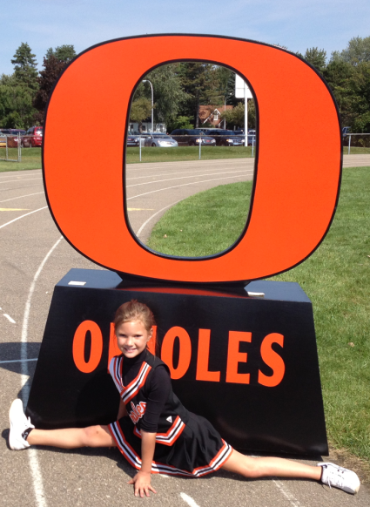
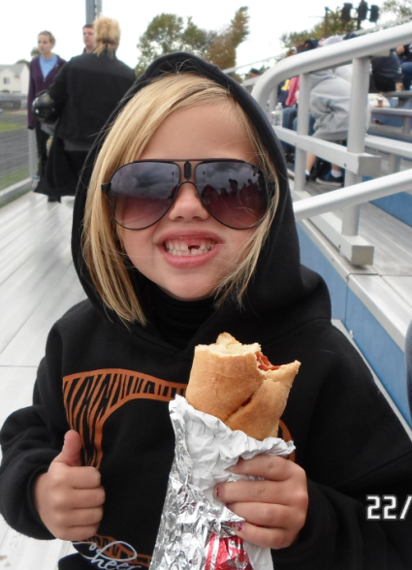
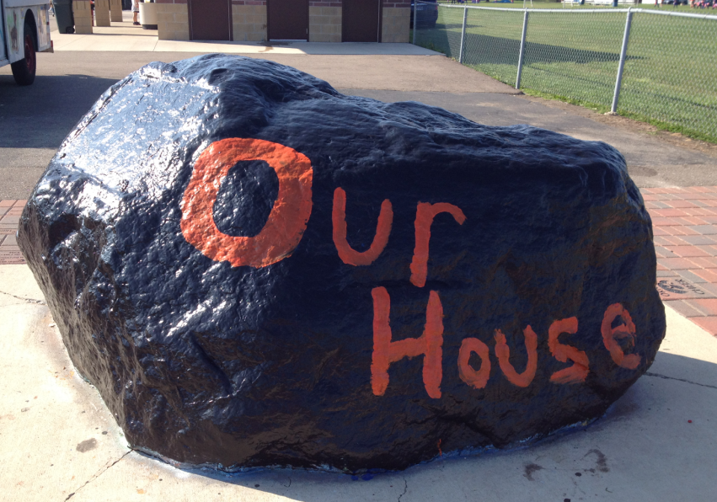
Oriole Website
ORIOLES CHEER
Check us out
Everything you need is just a click away
www.livoniaorioles.com
Contact Information
Updated Calendars, Forms, and Pictures

Slide 12

Uniforms & Cheer*Pack
ORIOLES CHEER
Skirt/Shell/Jersey/bag –provided & returned (bag can be purchased)
Cheer Pack includes:
Cheer Shoes
Black Long Sleeve Bodysuit
Black Short
Black Dance Pants
Event t-shirts
Game day Bow/Competition Bow
Embroidered Jacket/Hoodie
Rain poncho
Cheer Camp
*Cheer Pack Party-all pack items given out at camp
Notes:
Uniform inspection will be 8/23 before Pep Rally

Slide 13
Cheer Bag
Uniform/Dress
Practices:
Shorts / Tee-shirts are best for warmer evenings.
Sweat-pants / sweat-shirts for cooler evenings.
Proper Athletic Shoes are REQUIRED.
No Jeans, skirts, skorts, string tank tops, or Jewelry of any kind.
Hair MUST be pulled back off face.
Games: ALWAYS bring complete uniform in bag. Coaches will advise on uniform, it may change through-out the game.
*Please note: Do not get cheerleaders ears pierced anytime between May-November
ORIOLES CHEER
Complete Uniform (game days)
Band-Aids
Hair Ties
Hoodie
Dance Pants
Rain jacket/poncho
Sun Block
Bug Spray
Water
*Please note WATER is the only drink allowed at practice and at games.
Notes:
No Jewelry rule will be enforced for safety purposes. Full uniform includes, hoodies, spanks, cheer socks, black yoga pants, skirt, shell, body suit and bow.

Slide 14
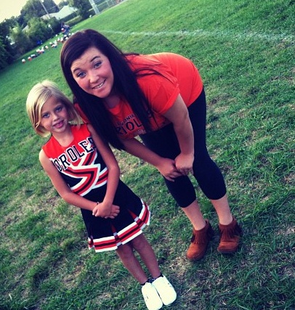
Frequently Asked Questions
ORIOLES CHEER
Common Questions…
???-Attendance Rules—we need you present!
???-What to bring/wear—fully packed cheer bag!
???-Practice Field Drop Off --- girls should not bring friends
???-Placement --- determined by coaches –rotating lines
???-Injuries—2 minute rule
???-Weather—we cheer in the rain!
Where you can find the Answers…
*Our Handbook
*Our Website
*Weekly Squad Emails
*Your Coach
*Cheer Coordinator/FB Directors

Slide 15
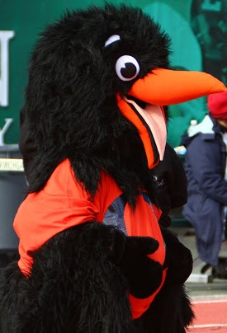
Coaches Communication
ORIOLES CHEER
Our Primary form of communication---
Weekly Email from Coaches
Team Parents Briefing-AUGUST
Team Rules/Consequences
Team Expectations
Q & A
24 Hour Rule
Coaches 1st - Directors 2nd
Never address concerns to the JR coaches
Please Be Available by cell during all
Practices & Games! Thank you!
Notes:
Most team rules are the same across the board, however, there are a few things that vary by squad due to age.

Slide 16
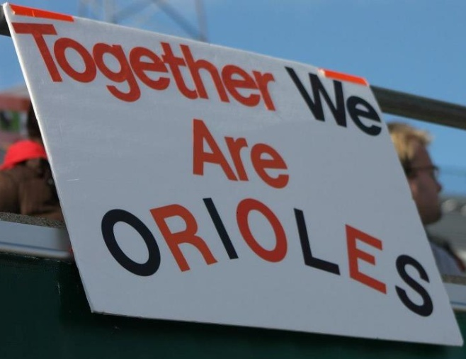
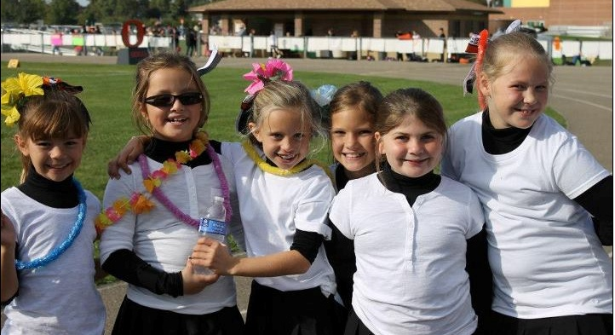
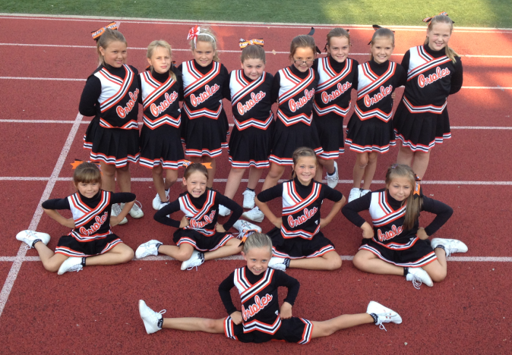
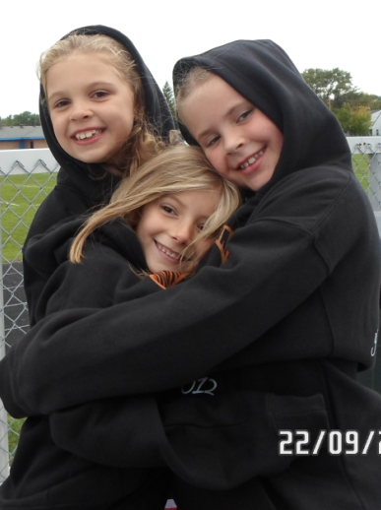
Parental Communication
Be respectful of other parents
Coaching from the Bleachers
Participation & Crowd Response
Attitude & Effort
Unconditional Love
Show your support, not your displeasure
ORIOLES CHEER

Slide 17
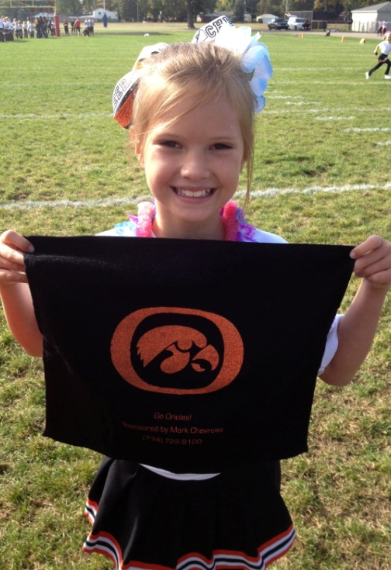
Keep it in Perspective…
ORIOLES CHEER
82% of student athletes say their parents are too aggressive in
the stands.
Only 10 of every 12,000 high school athletes go on to play
collegiately.
75% of kids quit athletics by the age of 16,
citing parental pressure as the #1 reason.
There is a lot more money available with
academics than athletics!

Slide 18





The Worldwide Web
50% of athletic discipline issues
last year began with theses icons.
Livonia Orioles Official Facebook Website is used for informational purposes only!
Wall posts are allowed provided they are positive and not of a personal or individual nature.

Slide 19
Sportsmanship
ORIOLES CHEER
If You want this to be taught by our Coaches,
YOU are going to have to promote it yourself.
Please, Please, Please…SHOW YOUR
SUPPORT, NOT YOUR DISPLEASURE.
Thank you for your attendance this evening
and your kind and continued support.

