Slide 1
2014 Sequoyah Touchdown Club
Partnership Guide
Join the Chiefs Nation
Put the excitement of Sequoyah Football to work for you through a partnership with the Chiefs
The Sequoyah Touchdown Club is a 501(c)3 Organization

Slide 2
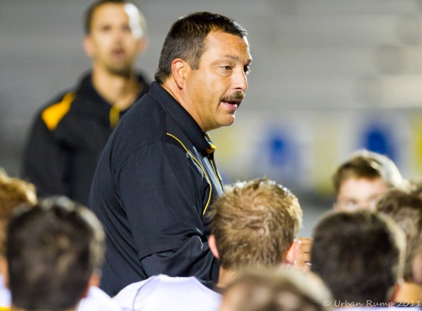
A Note from the Coach
The support we receive each year from our community, fans and our corporate partners is a testament to the strength of this community. I am very proud to represent Sequoyah High School and our football program. Year after year I am amazed by the contributions of our corporate partners. These contributions are essential to the success of our program and are an integral part of the development of our student-athletes.
The Sequoyah Touchdown Club, our players, coaches and I look forward to welcoming your business as a proud partner of Sequoyah Football.
I can assure you that we will work as hard as we can on and off the field to represent our partnership at the highest level. We will continue investing in our community and your business.
Sincerely,
Jim Teter
Head Football Coach
2014 Sequoyah Touchdown Club Partnership Guide
The Sequoyah Touchdown Club is a 501 (c) 3 Organization

Slide 3
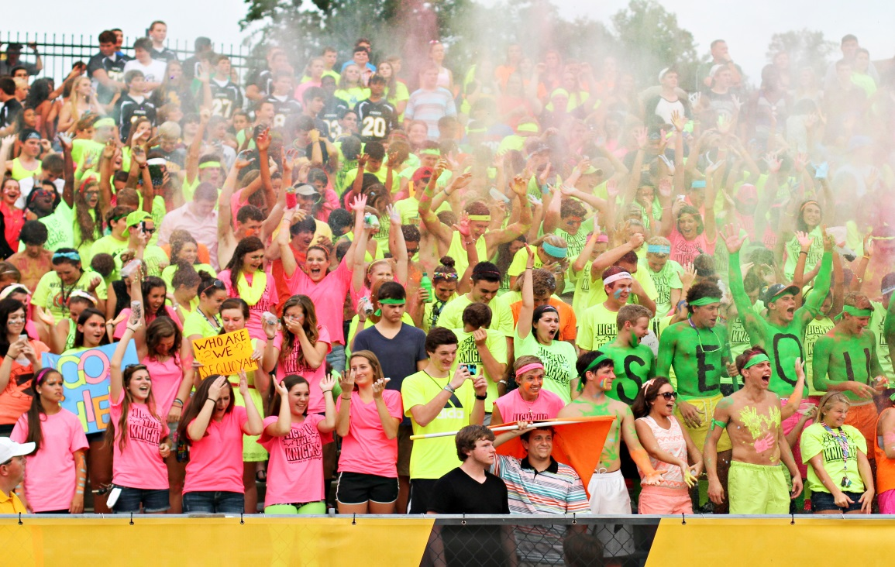
2014 Partners
C
onnect with the players, coaches, Sequoyah Touchdown Club and the community to develop a mutually beneficial partnership for all parties involved.
H
elp the Sequoyah Touchdown Club generate the financial resources needed to cover basic operational costs, upgrade facilities, and enhance the game day experience for all.
I
nvest in the Hickory Flat community through your support of the local team and develop brand recognition for your company through your partnership with Sequoyah Football.
E
njoy exposure for your company throughout the entire 2014-15 school year as your message is seen at all events held at Skip Pope stadium.
F
riends of the program that play a critical role in helping develop Sequoyah Football into a State Powerhouse.
S
upport the Sequoyah Football mission of Developing Champions for Life.
2014 Sequoyah Touchdown Club Partnership Guide
The Sequoyah Touchdown Club is a 501 (c) 3 Organization

Slide 4
Partnership Opportunities
 | Ultimate Partner $7500 (2 Year) | Platinum Partner $2500 (1 Year) | Gold Partner $2500 (2 Year) | Black Partner $800 (1 Year) | Premier Partner $500 (1 Year)
Post Game Email Partner
Scoreboard Recognition
Game Day Announcement/Recognition
Partner Recognition Board
Website Ad & Hyperlink
Partner Appreciation Plaque
Game Program Advertisement | 1/2 Cover or Outside Back Cover | Half Page | 1/3 Page | 1/4 Page | 1/8 Page
Social Media Advertisement | Final score and game recap FB & Twitter updates. FB AD & Link | Halftime & 3rd Qtr score via Twitter. FB small Ad & Link | 1st Qtr score via Twitter. FB Link | FB Link | N/A
Season Tickets and Parking Pass | 6 VIP Reserved and a Parking Pass – Must be requested | 4 VIP Reserved and a Parking Pass – Must be requested | 4 Reserved and a Parking Pass – Must be requested | 2 General Admission | N/A
Intro Partner
$300
(1 Year)
N/A
N/A
N/A
2014 Sequoyah Touchdown Club Partnership Guide
The Sequoyah Touchdown Club is a 501 (c) 3 Organization

Slide 5
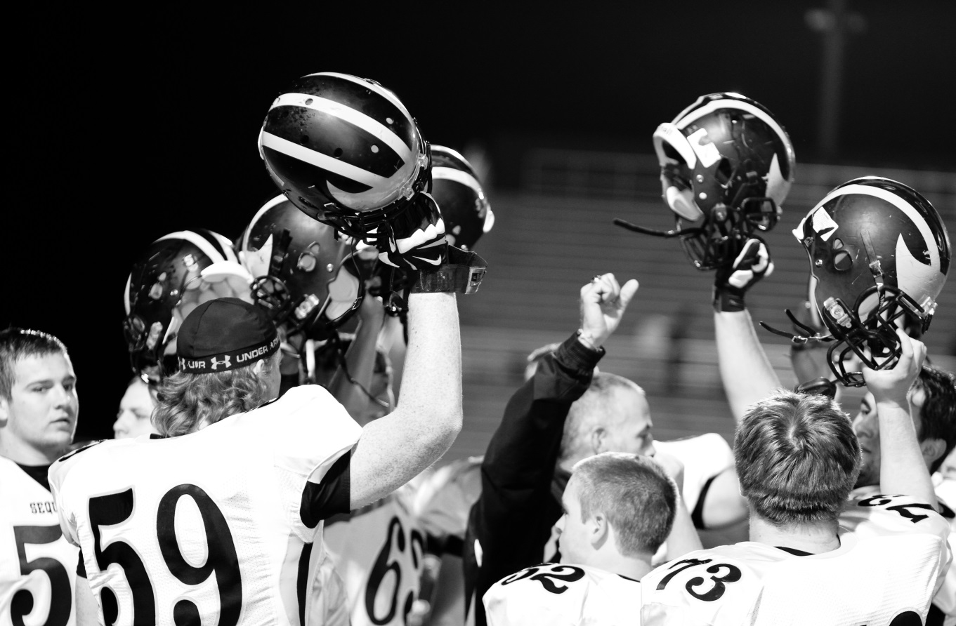
Post Game Email Partner
Your company name used as the header for the game recap email sent out following a varsity game
Email sent to all fans registered on the Sequoyah Touchdown Club website
2014 Sequoyah Touchdown Club Partnership Guide
The Sequoyah Touchdown Club is a 501 (c) 3 Organization

Slide 6
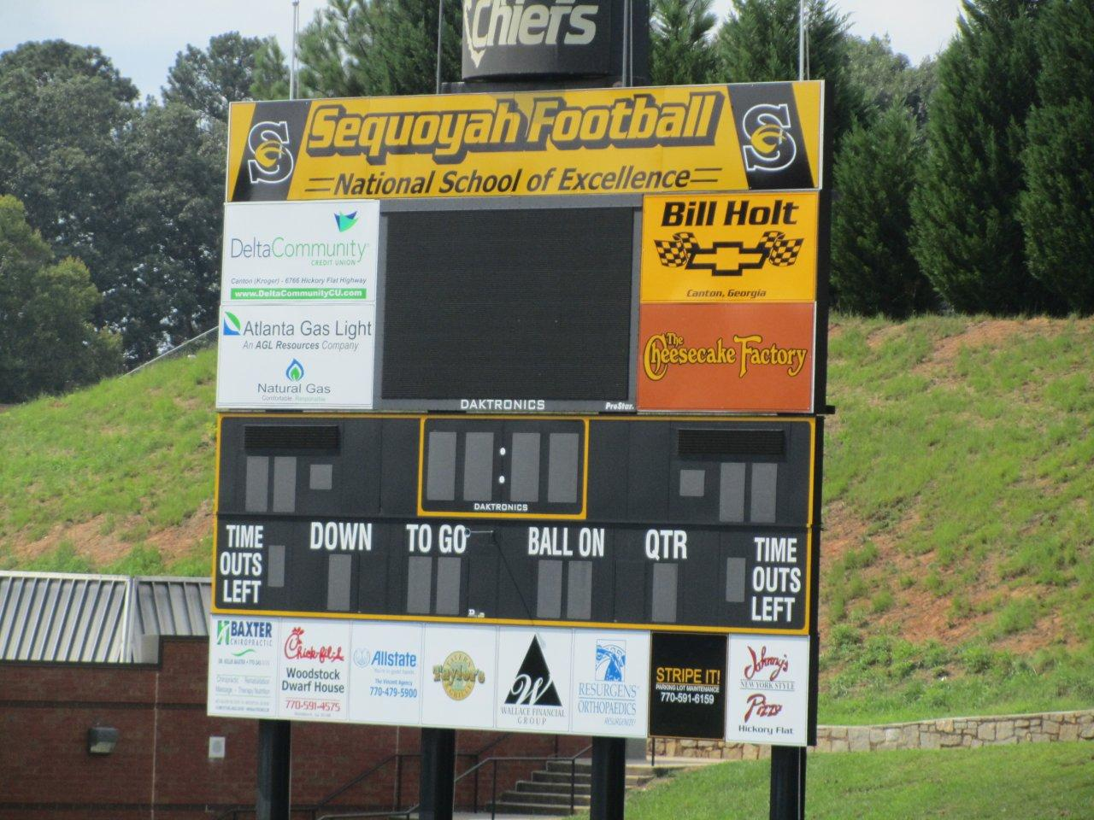
Scoreboard Recognition
Exclusive Scoreboard Partner for all of 2014-2015 School Year
Message seen at every event that takes place in stadium
Ultimate Partner – Placement along top banner
Platinum Partner – Full Color Logo Sign 4’ x 8’
Gold Partner – Full Color Logo Sign 4’ x 4’
2014 Sequoyah Touchdown Club Partnership Guide
The Sequoyah Touchdown Club is a 501 (c) 3 Organization

Slide 7
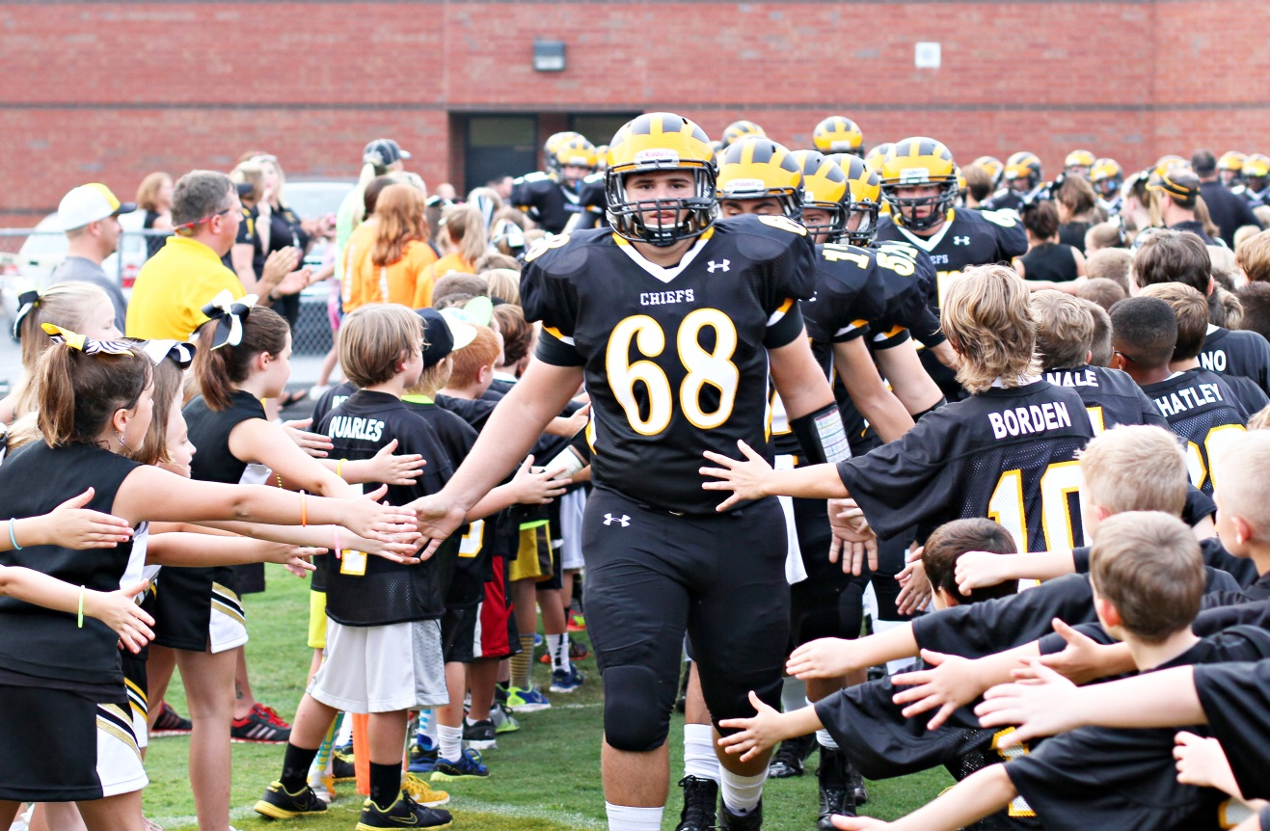
Game Day Recognition
Recognition at all home football games
Continuous scrolling logos and sponsor names on the Video Board for the Black and Gold game, Powder Puff game, and all Freshman, JV, Varsity, Middle school and CYFA football games. (30,000 annual Estimated attendance)
Short announcement (written by the sponsor) read at every football game
2014 Sequoyah Touchdown Club Partnership Guide
The Sequoyah Touchdown Club is a 501 (c) 3 Organization

Slide 8
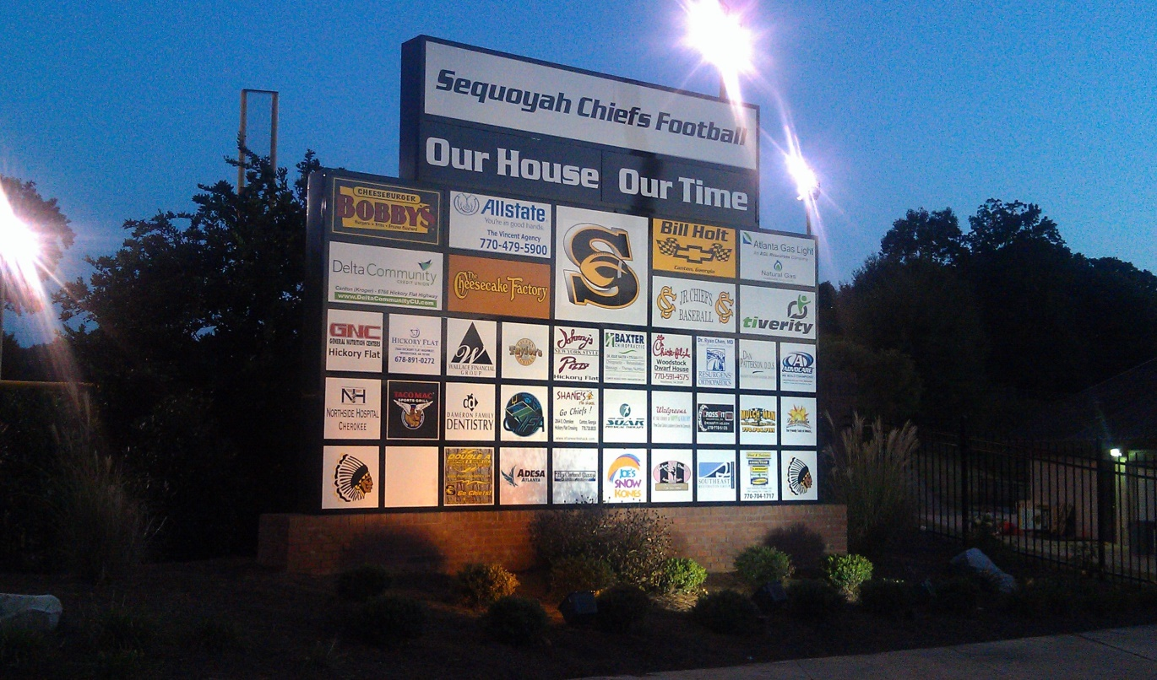
Partner Recognition Board
Partner Recognition for all of 2014-2015 School Year at all events in Skip Pope stadium
Message seen by every fan entering Skip Pope stadium from the home field side and by every fan entering the Sequoyah Baseball Field
24 hours a day, 365 day a year exposure to all Freshman, JV, Varsity, Middle school, CYFA football games, girls and boys track meets, boys and girls soccer games, JV and Varsity baseball games
Ultimate Partner - Full-Color Logo Sign 2’ x 7’
Platinum Partner - Full-Color Logo Sign 2’ x 4’
Gold/Black Partner - Full-Color Logo Sign 2’x 2’
2014 Sequoyah Touchdown Club Partnership Guide
The Sequoyah Touchdown Club is a 501 (c) 3 Organization

Slide 9
Website Ad & Hyperlink
Banner ad on the Sequoyah Touchdown Club website:
www.sequoyahfootball.com
Hyperlink to your website
2014 Sequoyah Touchdown Club Partnership Guide
The Sequoyah Touchdown Club is a 501 (c) 3 Organization

Slide 10
Social Media Advertisement
New this year, Sequoyah has developed a social media initiative to promote the program and our partners. We have developed pages for Facebook, Twitter and Instagram. This offers us opportunities to promote our partners during home and away games as we send out game score updates and recaps to our followers . We are also offering the following opportunities to exclusively sponsor various plays of the game highlights that will be sent out postgame during the week to our followers.
 | Single Game | Season (10 Games)
Play of the Game | $75 | $600
Hit of the Game | $75 | $600
Catch of the Game | $60 | $500
Run of the Game | $60 | $500
Note* Single games available only if there isn’t a complete season sponsor.
2014 Sequoyah Touchdown Club Partnership Guide
The Sequoyah Touchdown Club is a 501 (c) 3 Organization

Slide 11
Spotlight on 2014
There has never been more or better opportunities for you to align your business with the Chiefs and share in the excitement that is Sequoyah Football.
Maximum Exposure: New Regional Line-up
Including county rivals Creekview and River Ridge
Return to Prominence: Sequoyah Football has re-established itself as a perennial state playoff contender with two straight playoff appearances
Complete commitment to your business: The Sequoyah Touchdown Club, coaches, players and Sequoyah community are committed to our corporate sponsors and their businesses.
Thank you so much for your contributions and support!!
Sincerely,
Jeff Wells
President – Sequoyah Touchdown Club
2014 Sequoyah Touchdown Club Partnership Guide
The Sequoyah Touchdown Club is a 501 (c) 3 Organization

Slide 12
Partner Commitment Traditional Sponsorship Packages
____ Ultimate Partner $7500 (2 Year Partnership) | ____ Black Partner $800 (1 Year Partnership)
____ Platinum Partner $2500 (1 Year Partnership) | ____ Premier Partner $500 (1 Year Partnership)
____ Gold Partner $2500 (2 Year Partnership) | ____ Intro Partner $300 (1 Year Partnership)
__ Credit Card | __Check Enclosed | __ Please Invoice
__ AMEX | __ VISA | __ Master Card | __ Discover | CC#_________________ | EXP. ______
Zip Code for Credit Card Mailing Address ______________ CSV Number_________
OR YOU CAN PAY BY CREDIT CARD ONLINE AT WWW.SEQUOYAHFOOTBALL.COM
Name as it appears on the card: ______________________________________________________
Billing Address: ___________________________________________________________________
I authorize the Sequoyah Touchdown Club to charge my credit card as indicated above:
Cardholder Signature: ______________________________________________________________
Company Name: __________________________________________________________________
Address: ________________________________________________________________________
City, State, Zip: ___________________________________________________________________
Contact Name: ___________________________________________________________________
Telephone: ____________________ | Email: _________________________________________
For questions about becoming a partner, please contact Rod Bennett at rbennett124@gmail.com or by calling (770) 309-5255
Please send check, this form, and ad material(s)* to:
Sequoyah Touchdown Club
Attention: 2014 Partnership Package
6175 Hickory Flat Highway
Suite 110-235
Canton, Georgia 30115
AI or EPS Formatted Graphics are Preferable for Partner Recognition Board and Scoreboard Signs
Digital files can be sent to:
rbennett124@gmail.com
*original artwork and photos will be returned
2014 Sequoyah Touchdown Club Partnership Guide
The Sequoyah Touchdown Club is a 501 (c) 3 Organization

Slide 13
Partner Commitment Game Highlights Sponsorship
Business
Full Season __________ $600
Full Season __________ $500
Single Game__________ $75
Single Game __________$60
__ Credit Card | __Check Enclosed | __ Please Invoice
__ AMEX | __ VISA | __ Master Card | __ Discover | CC#_________________ | EXP. ______
Zip Code for Credit Card Mailing Address ______________ CSV Number_________
OR YOU CAN PAY BY CREDIT CARD ONLINE AT WWW.SEQUOYAHFOOTBALL.COM
Name as it appears on the card: ______________________________________________________
Billing Address: ___________________________________________________________________
I authorize the Sequoyah Touchdown Club to charge my credit card as indicated above:
Cardholder Signature: ______________________________________________________________
Company Name: __________________________________________________________________
Address: ________________________________________________________________________
City, State, Zip: ___________________________________________________________________
Contact Name: ___________________________________________________________________
Telephone: ____________________ | Email: _________________________________________
Advertisement Graphic Provided Digitally: Yes or No Player Photo Required: Yes or No
For questions about becoming a partner, please contact Rod Bennett at rbennett124@gmail.com
or by calling (770) 309-5255
Please send check, this form, and ad material(s)* to:
Sequoyah Touchdown Club
Attention: 2014 Partnership Package
6175 Hickory Flat Highway
Suite 110-235
Canton, Georgia 30115
Digital files can be sent to:
rbennett124@gmail.com
*original artwork and photos will be returned
2014 Sequoyah Touchdown Club Partnership Guide
The Sequoyah Touchdown Club is a 501 (c) 3 Organization

Slide 14
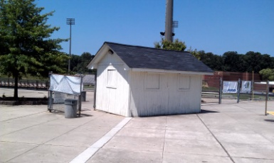
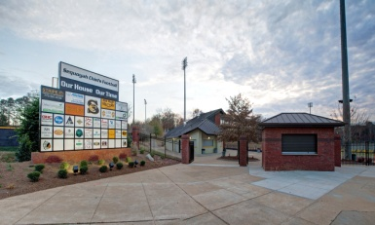
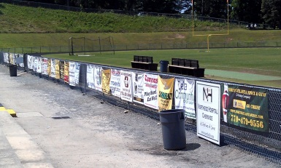
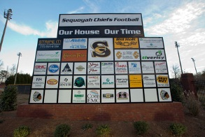
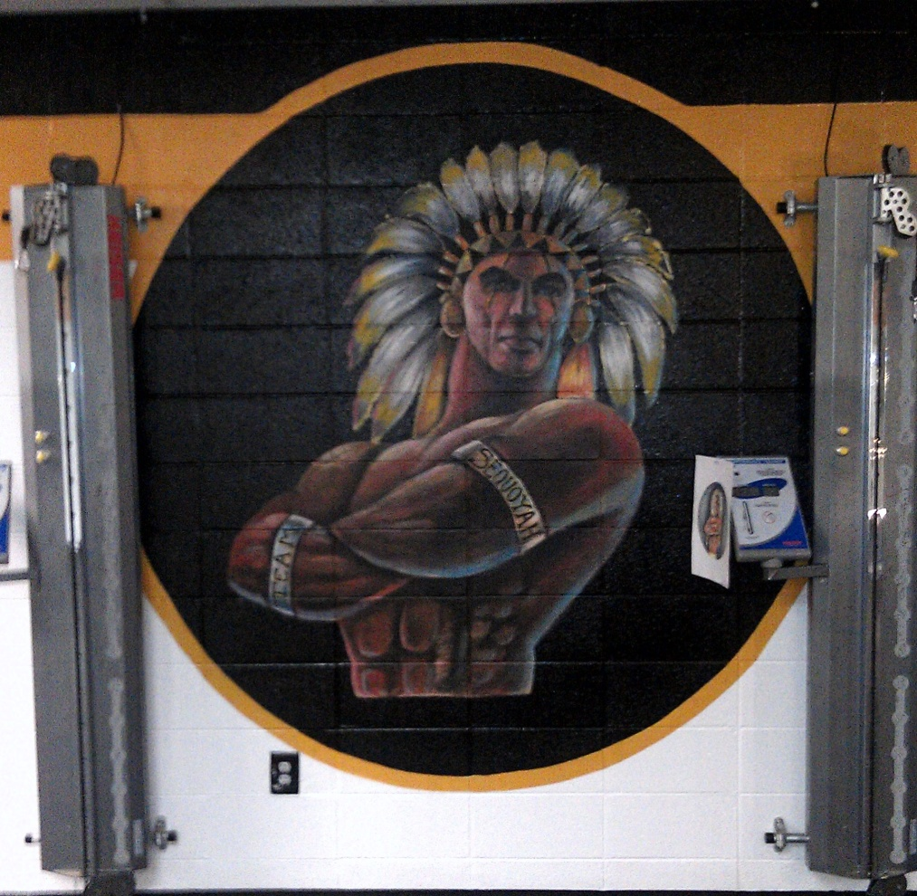
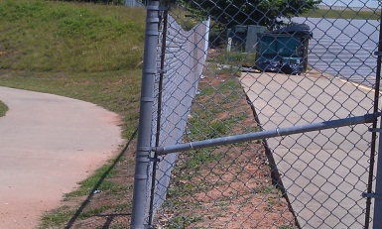
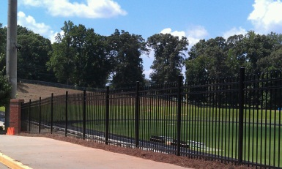
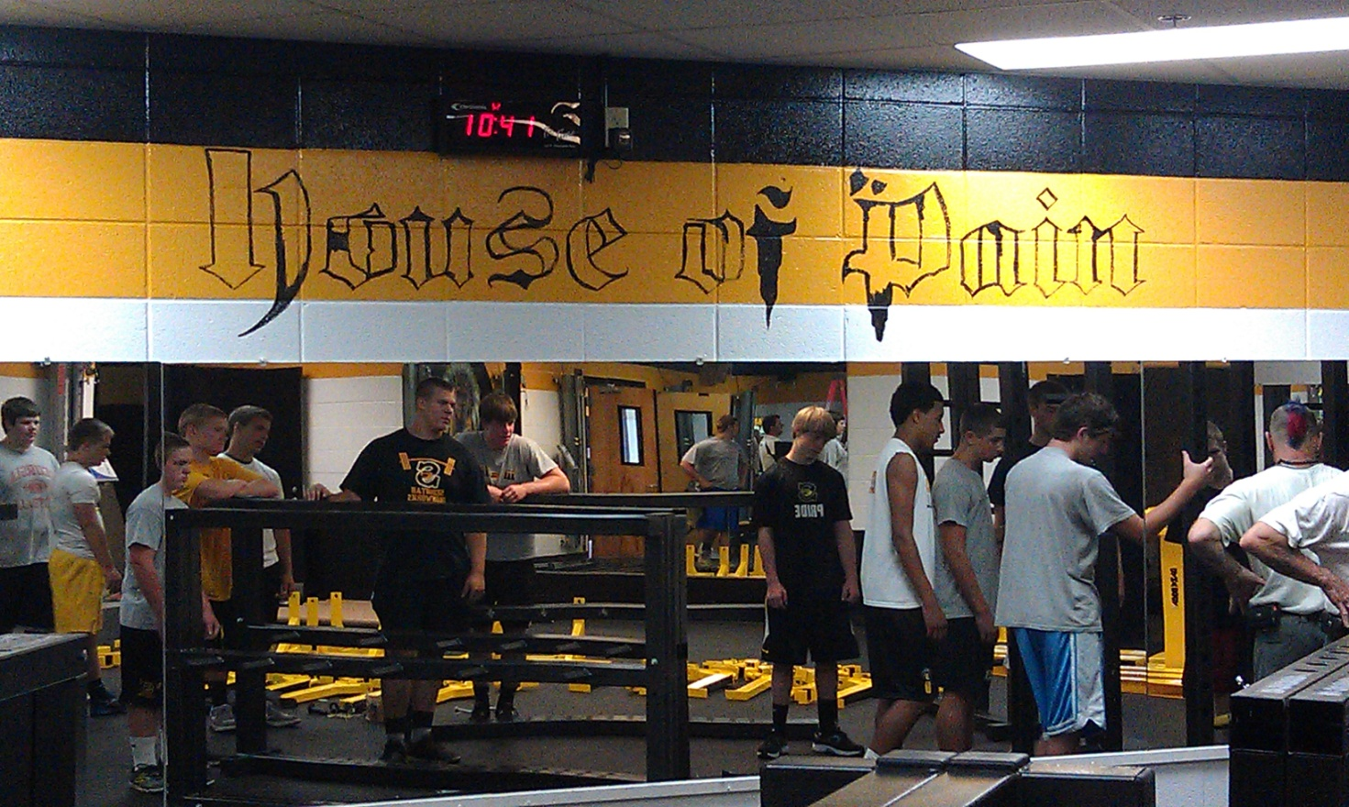
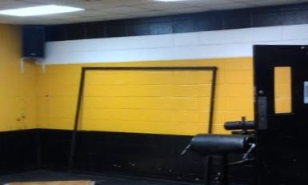
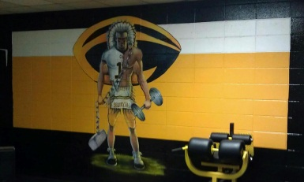
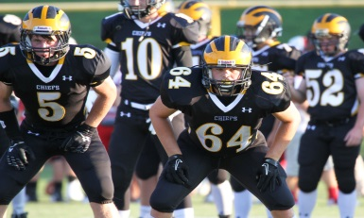
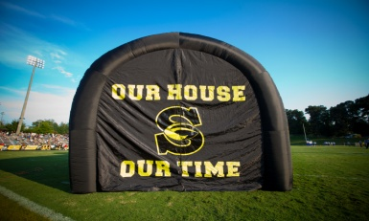
THANK YOU Progress through Partnership
2011 | 2012/2013 | 2013/2014
New Uniforms
2014 Sequoyah Touchdown Club Partnership Guide
The Sequoyah Touchdown Club is a 501 (c) 3 Organization

