Slide 1
WIN the DAY

Slide 2
WELCOME AND INTRODUCTIONS
Jeff Smith—Head Football Coach/Athletic Coordinator/Linebackers
Reid Waller—Asst. Head Coach/Defensive Coordinator/Safeties
Braden Smith—Offensive Coordinator/QB’s
Mark Gibson—Offensive Line
Glenn Williams—Offensive Line
Anthony Sowe—Defensive Line
Ryan Ledford—Running Backs
Will Secord-Receivers
Justin Smith—Secondary
Clint Coffman—Linebackers/Equipment
Scott Loy—Head JV Coach/Var. H Backs
Ryan Robertson—JV/Var. Offensive & Defensive Line
Dalton Conway—JV/Var. Linebackers/Receivers
Ryan Gros—JV/Var. Skill Players
Andy Brown—Head 9th Coach/Linebackers/Offensive Line
Phillip Meaker—9th Coach/Offensive & Defensive Line
David McWhirter—9th Coach/Offensive and Defensive skill
Kevin McGlathery—9th Coach/Offensive and Defensive skill
Emma Gorman—Athletic Trainer
Jake Mannis—Athletic Trainer
Julie Lee—Athletic Secretary
Joe Cable & Elliot Parkman

Slide 3
OLD HIGH TRADITION
Over 50 playoff appearances
3 State Championship Appearances
1966
1979 Won State Championship
1986
We have great tradition! It’s our turn to add to this rich legacy!

Slide 4
5 Pillars of McKinney High Football
L -- Leadership
I -- Integrity
O -- One
N -- Never Quit
S -- Selfless

Slide 5
2017 THEME
WIN the DAY

Slide 6
Necessary Paperwork
General Information
MISD Regulation/Expectations
UIL Acknowledgement of Rules
MISD Information Release Form
Player Information Sheet
Cardiac Awareness Form
UIL Parent/Student Steroid Form
Proof of Residency—Water or Electric bill
Concussion Guidelines & Consent Forms
Co-Curricular/Extra-Curricular Contract
Verification of Bona Fide Residence
Emergency Contact Information
9th—Copy of Birth Certificate

Slide 7
ONLINE PAPERWORK LINK
http://mckinneyisd.rankonesport.com
We have tables set up in the hallway to check your son’s status. Please check
We can make copies of bills for you

Slide 8
Expectations of Parents
Supportive and Encouraging through high’s and low’s
Please preach the “team” concept
Please support your son’s coaches
Please encourage your son to follow team rules
Please insist that your son do well in the classroom as well as on the field
Be a huge Lion Fan!!
If you have questions or concerns please communicate with us.

Slide 9
Expectations of Coaches
Positive and enthusiastic
Prepared and organized
Open to communication
Will work as hard as possible to get job done
To be a model that exhibits character and integrity on and off the field
To teach these young men the game of football to the best of our ability

Slide 10
Fall Practice Schedule
9th Grade
Athletic Period—1st period—Ready to go at 7:15am
After School Practice 2:50-5:15
JV/Varsity—5th period—E lunch
After School Practice 2:50-6:00

Slide 11
Mentor Groups
Each Group—10-15 student athletes
Each Coach’s responsibility
Team academic awards
Tutorials—Study Hall on Wednesday’s

Slide 12
Absences and Tardiness
If absent—Please call and leave the coach a message about why you are absent
Coach Smith’s—469-302-5959 (message no text)
Coach Loy’s email—
sloy@mckinneyisd.net
Coach Brown’s email—
anbrown@mckinneyisd.net
Coach Smith’s email—
jefsmith@mckinneyisd.net

Slide 13
Equipment
EQUIPMENT
All Provided – Use Ours
Exception – Shoes and Socks
LAUNDRY
Done Everyday
Consequences if Laundry left home

Slide 14
LOCKERS
Everyone has locks w/Combo’s
Must be locked at all times, going to shower, visiting with friends
Players cannot tape their combination in site
Usually left unlocked and unattended when something is stolen. Leave large amounts of money at home, keep wallets, IPODS, etc… locked up at all times.

Slide 15
Game Day Information
Food—Drop off is at Mrs. Foyt’s office—just write the name on the bag and leave on table.
JV/9th—Possible Meal options--TBD
Varsity meals will be provided
Student/Athletes are not to leave campus
The Dome will be shut down

Slide 16
Care of Athletes
Training Room Procedures: (AT Jake and AT Emma)
Doctor Troy Diehl
Injuries—See our trainers first
Physicals
Heat Related Illness
IMPACT Testing

Slide 17
Varsity Season Ticket Information
Please check with the MISD Athletic Office
Last Chance to Buy Tickets
MISD athletic office, #1 Duval St. McKinney, Tx

Slide 18
MISD Sports Passes
Available online or in the MHS athletic office
Cost is $50.00 for students and $75.00 for adults
For all misd home games except varsity football and post-season tournaments

Slide 19
Fall Kickoff Cook-out
August 24th
6-7 pm
McKinney HS Back Porch

Slide 20
TEAM FUNDRAISER
Why do we do this?
Provide extra equipment needs
Budgets are tight
Snap-Raise Online Donation--Spring
Discount Cards—Taking place now!
Please help sell
1st Blitz—Thursday, Aug. 24—7-9pm
After Kickoff Cookout we will send boys out
2nd Blitz—Saturday, Aug. 26—10-noon—pizza after

Slide 21
Website Information
www.mckinneyhighfootball.com
--McKinney Lions Football Booster Website
www.mckinneyisd.net
Follow links to “athletics”, “misd athletics”
Misdgo—smartphone app.
Rank One

Slide 22
Contact Information
Jeff Smith—Head Football Coach/Campus Coordinator –469-302-5948
jefsmith@mckinneyisd.net
Julie Lee—Athletic Secretary--469-742-5948
jlee@mckinneyisd.net

Slide 23
McKinney Lion Football Club
President—Jeremy Gilstrap
Vice President—John Mathey
Treasurer—Susie St. Leon
Secretary—Kip Dixon
**Please visit our tables to buy some gear or sign up to help out our boys.

Slide 24
McKinney Lion Football Club
PURPOSE:
Support McKinney High Football Program
PROGRAMS:
Spiritwear
Team Needs (uniforms, equipment, filming equipment)
Players Health Support (chocolate milk, Gatorade, PB&J)
Videographer
HUDL Account
In Season Event Coordination (Pregame meals, coaches Saturday meals, teacher appreciation, etc…)
Post Season Banquet
(2) $2000 Scholarships (awarded to seniors whose parents are members of the booster club)
Volunteer Coordination
Fundraising

Slide 25
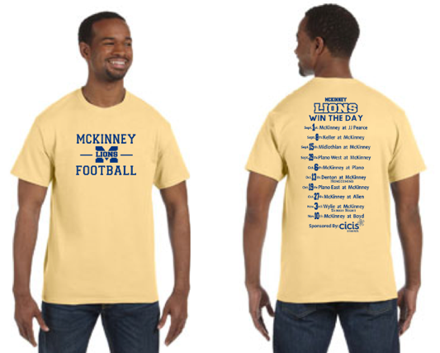
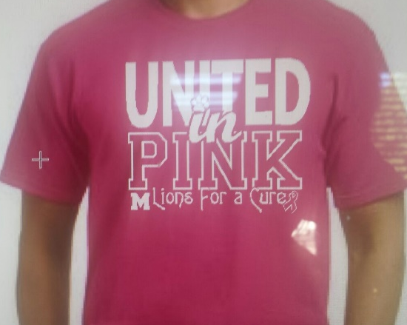
Spiritwear

Slide 26
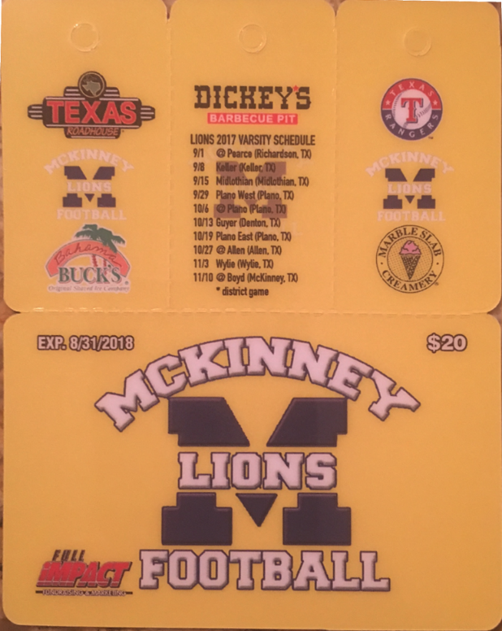
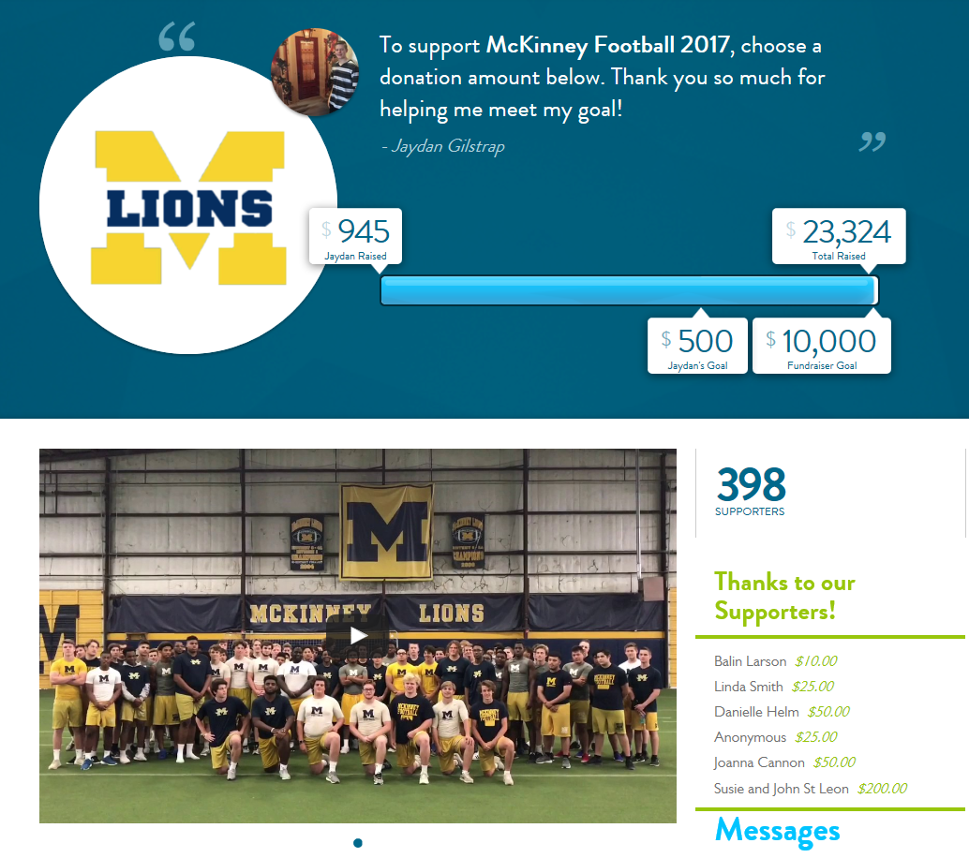
Fundraising
1
McKinney High Football Club Membership
2
Card Fundraiser
Snapraise
3

Slide 27
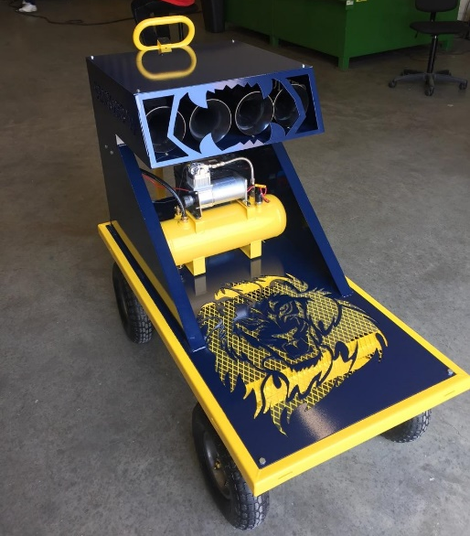
Volunteer Opportunities
General Volunteer!!!!
Varsity Team Dinners
Sub varsity Game Day Meals
Teacher Appreciation
Coaches Meals
Team Banquet
Game Day Team
Sign up in back
or email jgilstrap@strongtie.com

Slide 28
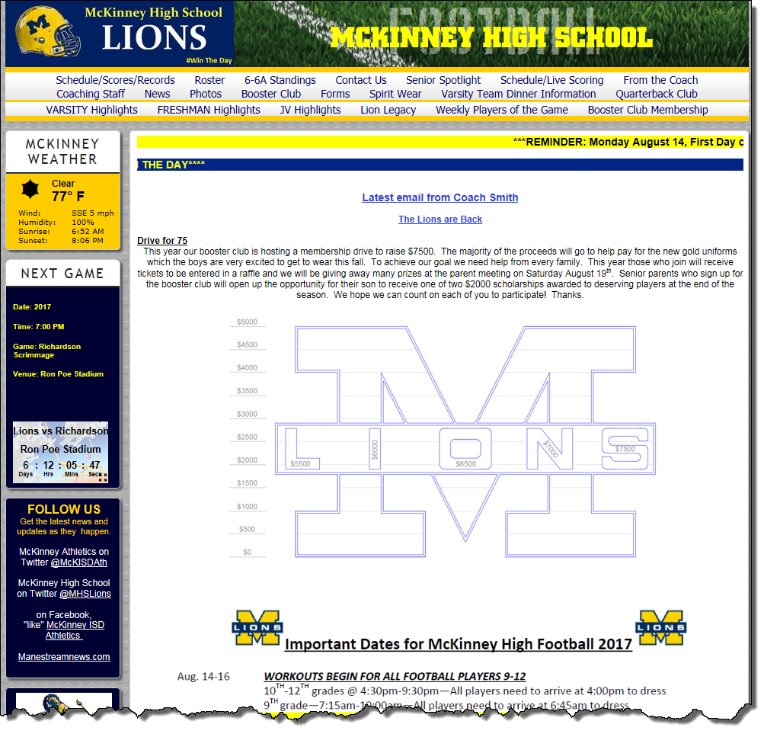
Website
www.mckinneyhighfootball.com

Slide 29
Questions??

