Slide 1
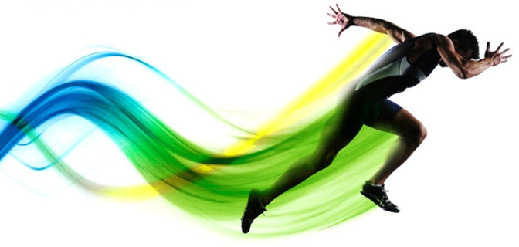
Sports Nutrition
Kelsey Johnson

Slide 2
Standard Football Nutrition Recommendations
Fat
Provides energy, insulation, cell structure, nerve transmission, vitamin absorption, and hormone production.
0.45 grams of fat per pound of body weight per day.
Proteins
Building blocks of human structure.
0.6-0.8 grams of PRO per pound of body weight per day.
Carbohydrates
Provides primary and preferred energy source.
2.7 grams of CHO per pound of body weight per day
3.6-4.5 grams of CHO per pound of body weight during hard training.

Slide 3
Pre-exercise Meal
Eat 3-4 hours before an event providing 200-350 grams of carbohydrates (4 g/kg).
Avoid high fat and fiber.
Meal Examples
scrambled egg white with white toast/jam and banana
1 bagel with fat-free or low-fat cream cheese and jelly and 1 banana
6” turkey sub on Italian bread with lettuce/tomato and mustard
3-oz grilled chicken breast with small baked potato and roll
2 cups plain pasta with 1 plain roll
1 can of low fat sport shake no more than 25 grams of protein, 1 sports bar, and 1 banana

Slide 4
Pre-snack
Unable to eat large meal.
Consume high carbohydrate snack (1g/kg) less than 1 hour before exercise.
Snack Examples
fresh fruit (banana, orange slices)
½ energy bar
½ bagel or English muffin
8-12 oz sport drinks (Gatorade, PowerBar Endurance Sports Drink)

Slide 5
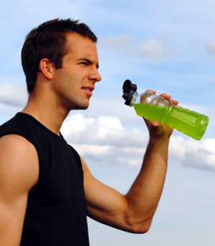
During Exercise
Exceed 60 minutes refuel with 30–60 grams of carbohydrates every hour.
Preferable carbohydrate source sport drinks or rice crisp treats at half-time.

Slide 6
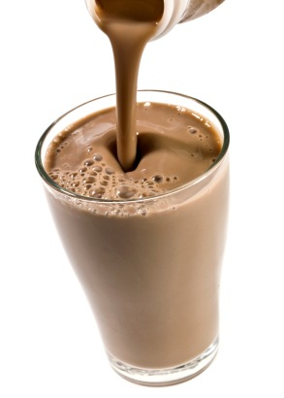
Food Recovery
“Recovery window” is 30 minutes -1 hour after exercise.
Consume about 40–80 grams of carbohydrates and 10–20 grams of protein after exercise.
Drink plenty of fluids.
Replenish electrolytes.
Eat a meal within 2 hours of exercise.
Post-exercise snack ideas:
16 oz low-fat chocolate milk
turkey sandwich
banana + whole wheat crackers + PB
fruit and greek yogurt

Slide 7
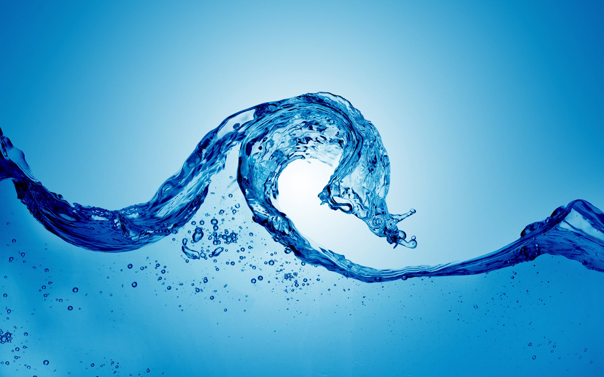
Hydration for Athletes
Water regulates the body temperature, lubricates joints, and helps transport nutrients for energy and health.

Slide 8
How much water should I be drinking?
There are no set guidelines for water intake while exercising because everybody is different.
Sweat rate, humidity, exercise intensity, and urination influence water intake.
Simple way to make sure you’re staying properly hydrated is to check your urine.

Slide 9
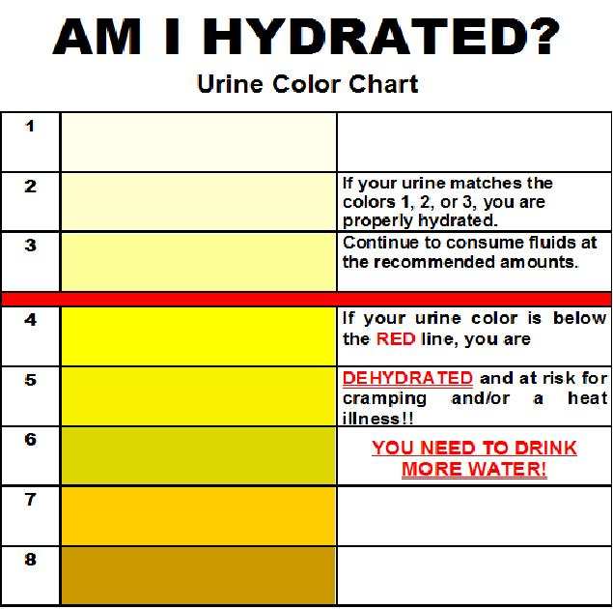

Slide 10
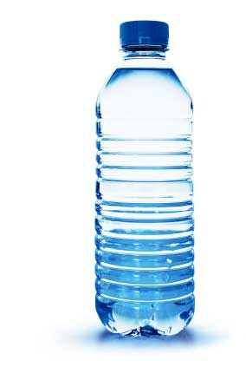
Signs of Dehydration
Thirst
Irritability
Headache
Weakness
Dizziness
Cramps
Nausea
Decreased performance
Severe dehydration can lead to death

Slide 11
Before Activity
Drink at least 17-20 oz of fluid 2-3 hours before practice or a game.
Consume 7 -10 oz fluid 10-20 minutes before competition.
REMEMBER 1 gulp = 1 oz of fluids

Slide 12
What to Drink During Exercise?
Every 10-20 minutes drink 7-10 oz OR 28-40 oz of fluid per hour.
Less than 60 minutes exercise, water is a fine choice.
More than 60 minutes exercise, a sports drink should be consumed during the activity.

Slide 13
After Exercise
Immediately replace fluids lost.
Any weight lost during activity strictly fluid loss.
Weigh yourself before and exercise a few times to obtain weight loss average.
Every pound of weight loss, athlete should drink at least 20 oz of fluid.
Football players can lose up to 12 pounds of water weight.
Drink replacement fluids within 2 hours of finishing physical activity.
Sport drinks and water are good choices.

Slide 14
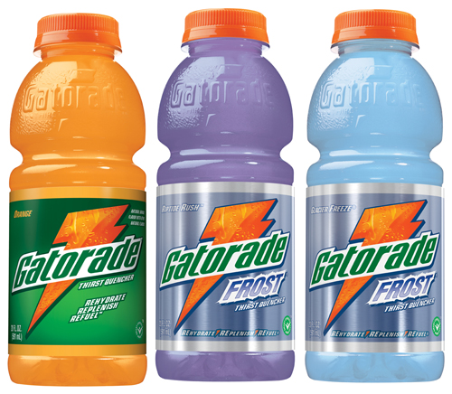
Sports Drinks
Drink with exercise longer than 60 minutes.
It helps keep blood sugar and electrolytes level balanced.
Choose sport drinks containing 14-18 gm of carbohydrates per serving and 100 mg of sodium every 8 oz.

Slide 15
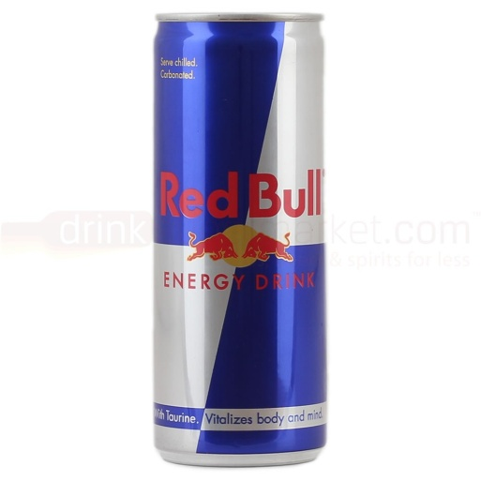
Energy Drinks and Sports
Contain around 450 mg of caffeine per bottle.
Adolescents should limit caffeine consumption to less than 100 mg daily.
Too much caffeine can cause:
An increased heart rate
Irregular heart rate and palpitations
Increased blood pressure
Sleeping issues
Increase urination
Dehydration (due to delay of absorption)
Very high levels of caffeine intake greatly increase risks of negative side effects and little evidence for any added athletic benefit.

Slide 16
Dietary Supplements
Around 50,000-75,000 dietary supplements on the market.
Examples of dietary supplements are branched-chain amino acids, creatine, and energy drinks.
Not regulated by the FDA unlike prescribed medications.
There is a lack of quality peer reviewed research on human subjects.
The long term side effects are not well studied, if at all.

Slide 17
Allows for product labeling claims as long as it does not diagnose, prevent, treat or cure a specific disease.
Claims can be made without scientific evidence.
Some supplement combinations are toxic especially with prescription drugs, other supplements, or consumed in excess amounts manufacturers’ recommendation.
Buy supplements involved in the UPS dietary supplement verified which meets voluntary standards for safety and purity.

Slide 18
Dietary Supplements
Understanding effectiveness, safe dosage, and possible side effects use the following resources.
Australian Sports Commission (referred by the USDA) http://www.ausport.gov.au
NIH Office of Dietary Supplements www.ods.od.nih.gov
National Center for Complementary & Alternative Medicine www.nccam.nih.gov

Slide 19
Questions
Contact me at kelsjohn02@gmail.com

