Slide 1
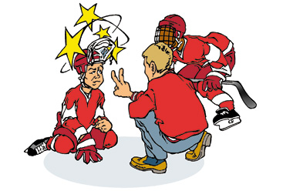
CONCUSSION GUIDELINES

Slide 2
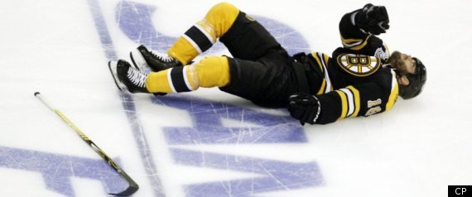
Nathan Horton Concussion Keeps Him Out Of Stanley Cup Final, Aaron Rome Suspension Follows

Slide 3
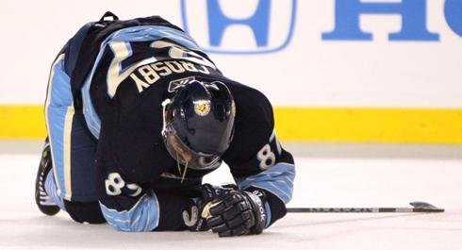
Sydney Crosby was out for almost a year with concussion-like symptoms

Slide 4
Each season, 10%–12% of minor league hockey players 9–17 years old who are injured report a head injury, most commonly a concussion

Slide 5
A concussion is a minor traumatic brain injury (TBI) that may occur when the head hits an object, or a moving object strikes the head causing a change in mental status. This kind of injury causes changes in the brain cells and generally results in the individual experiencing feelings of disorientation, difficulty with vision and possibly impaired coordination. It is important to note that a person does not have to lose consciousness in order to suffer a concussion.

Slide 6
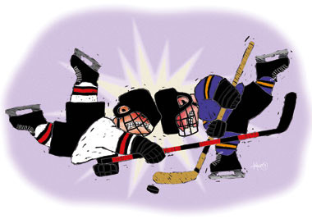
The majority (80%-90%) of concussions resolve in a short (7-10 day) period, although the recovery time frame may be longer in children and adolescents.

Slide 7
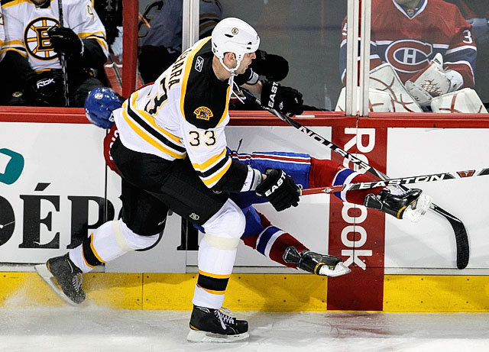
How Do Concussions Happen…..
Mid-Ice collisions
Hits along the boards
Falls
Puck/elbows to the Head

Slide 8
What are the Signs/Symptoms
Thinking Problems:
Sideline assessment:
What rink are we at today?
Which period is it now?
Who scored the last goal or who took the last penalty?
What team did we play last?
Did we win that game?

Slide 9
Athlete symptoms:
Headache
Dizziness
Feeling dazed
Seeing stars, or flashing lights
Feeling sleepy
Vision difficulty – double/blurry
Stomach ache, nausea

Slide 10
Coordination/Balance/Other Symptoms:
Poor balance and coordination
Slurred speech
Amnesia
Motor weakness
Slow to answer questions
Poor concentration
Strange emotional responses
Not playing well

Slide 11
Grades of Concussions:
Grade One concussion:
In this case, there is no loss of consciousness and symptoms usually last no longer than 15 minutes, but in any event, there is usually complete recovery within 24 hours.
The person may be a bit dazed or confused immediately after the incident, but improvement is quite rapid and there is usually no lasting effect.

Slide 12
Grade Two or Three:
There is usually a brief loss of consciousness
Symptoms in this case usually last longer than fifteen minutes, or will return with physical exercise and exertion.
Often, the person has no recollection of the incident causing the injury.

Slide 13
What Should Happen if an Athlete Receives a Concussion???
The Athlete Should Stop Playing the Sport Right Away!!!

Slide 14
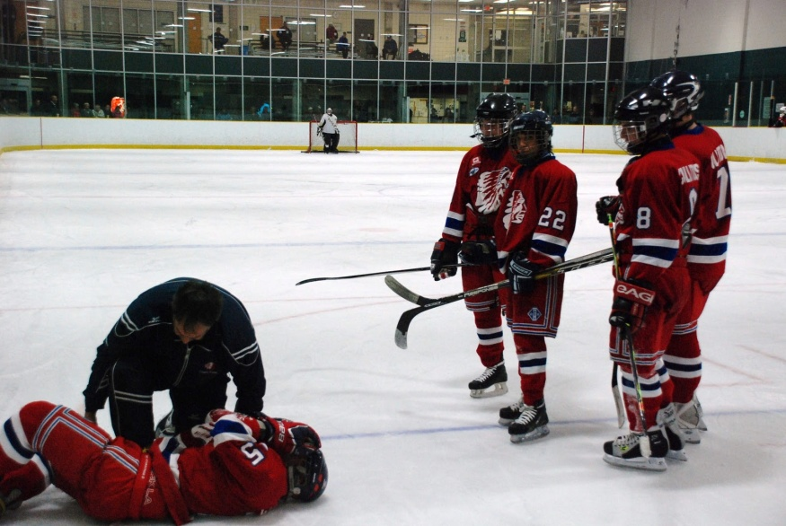
What if they are Knocked Out?
Call an Ambulance – dial 911
Consider Spinal Precautions!!!!!!

Slide 15
Coaches & Parents:
The coach should not even allow a player to return to the ice for at least 24 hours if it is suspected that he has suffered even a simple, Grade 1 concussion.
A hockey coach should never allow a player who has experienced a complex, Grade 2 or 3 concussion to return to practice or games without the approval of his doctor.

Slide 16
Therefore, after any blow to the head, it is imperative that the trainer do an immediate examination to determine if there is any symptom present which would suggest a concussion.
If there is the slightest sign of a concussion, the trainer must refuse to allow the player back on to the ice.

Slide 17
Even though a person who has suffered a mild concussion may appear fine within a few minutes after the blow, studies have shown that it still takes about 24 hours to fully regain his normal mental functioning abilities.
It takes at least a full week to recover from a complex, Grade 2 or 3 concussion.

Slide 18
Second Impact Syndrome…..
If a player returns to the ice too soon, he is risking what is referred to as "Second Impact Syndrome".
If he suffers a second concussion during this critical recovery period, his symptoms may last for months.
It is even possible that death will occur.

Slide 19
Return to Play…………..
It is Vital that an Athlete Does Not Go Back To Sports if They Have Any Concussion Symptoms at All

Slide 20
Return to Sport & Activity Following a Step-wise Approach
Step 1:
No Activity – complete rest – for both mind and body
Once back to normal – get cleared by an MD and then can progress to Step 2

Slide 21
Step 2:
Light Exercise such as walking or stationary cycling for 10 – 15 min
No resistance training or weight lifting

Slide 22
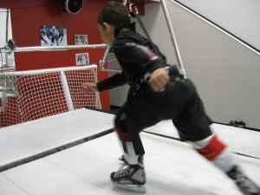
Step 3:
Sport specific aerobic activity for 20 – 30 min
Skating
NO CONTACT

Slide 23
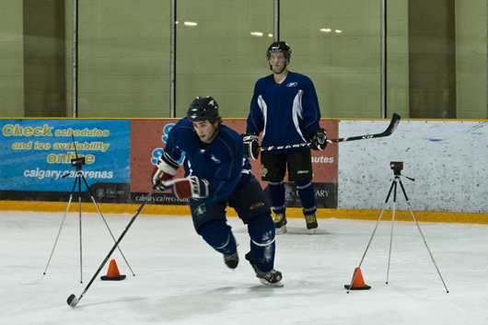
Step 4:
Practice Drills:
Puck handling
Shooting
NO BODY CHECKING

Slide 24
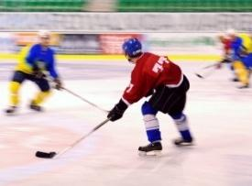
Step 5:
Requires clearance from MD
Full practice with Body Contact

Slide 25
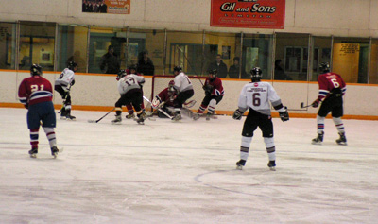
Step 6:
Game Play

Slide 26
Each Step must take a minimum of One Day
If Athlete has any reoccurrence of symptoms either during activity or later that day – stop the activity and rest until symptoms resolve for a minimum of 24 hours
Requires an MD clearance to start again

Slide 27
Post Concussion Syndrome…
In most cases, patients who experience concussion will recover fully, typically within days to months
The Center for Disease Control has noted that up to 15% may have persistent disabling symptoms beyond 3 months
When symptoms persist beyond the typical recovery period of three months we call this “Post-concussion Syndrome”

Slide 28
Symptoms of Post –Concussion Syndrome (PCS):
Headache
Dizziness/balance,
Fatigue,
Problems with vision,
Sensitivity to noise or light,
Insomnia
Cognitive problems involving memory, concentration and thinking
PCS can also result in behavioural changes such as moodiness (depression), irritability (anger), or an inability to sit still.

Slide 29
How Can a Concussion be Prevented?
Respect all players, coaches and officials.
Be aware - play heads-up hockey.
Always use correct bodychecking techniques
Never check to the head
Never hit from behind
Good fitting Helmet and Mouth Guard
Neck Muscle Conditioning

Slide 30
It takes cooperation from Players /Coaches /Parents to continue to enforce respect and safety in the game.

