Slide 1
WELCOME TO
HIGH SCHOOL VOLLEYBALL
-Orientation -

Slide 2
Parent / Coach Communication
Parent – Coach Relationship: SEE SEPARATE HANDOUT
Both parenting and coaching are extremely difficult vocations. By establishing an understanding of each position, we are better able to accept the actions of the other and provide greater benefit to children. As parents, if your child becomes involved in our program, you have a right to understand what expectations are placed on your child. This begins with clear communication from the coach of your child’s program.
Communication You Should Expect:
Philosophy of the coach.
Expectations the coach has for the team’s participants.
Locations and times of all practices and contests.
Team requirements, e.g., fees, special equipment, off-season conditioning.
Discipline which results in the denial of your child’s participation.
Communication Coaches Expect From Parents:
Notification of any schedule conflicts well in advance (weeks).
Health concerns related to your student-athlete.
Last minute family emergencies.
As your child becomes involved in the girls volleyball program at Blue Springs South High School, they will experience some of the most rewarding moments of their lives. It is important to understand that there also may be times when things do not go the way you or your child wishes. At these times appropriate discussion with the coach is encouraged.
It is very difficult to accept your child’s not playing as much as you may hope. Coaches are professionals. They make judgment decisions based on what they believe to be best for all students involved. As you have seen from the list above, certain things can be and should be discussed with your child’s coach. Other things, such as those listed below, must be left to the direction of the coach.
Issues Not Appropriate to Discuss with Coaches:
Playing time, Other student-athletes, Team strategy, Play calling

Slide 3
Parent / Coach Communication
There are situations that may require a conference between the coach and the parent. It is important that both parties involved have a clear understanding of the other’s position. When these conferences are necessary, the following procedure should be followed to help promote a resolution to the issue of the concern
This is the procedure a parent should follow if you have a concern to discuss with the head coach:
Make sure your athlete has already tired to communicate with a member of the coaching staff regarding the concern before setting up an appointment involving parents and coaches. Many issues can be solved by open lines of communication between the athletes and coaches.
Furthermore, this is the procedure a parent should follow if there still is a concern to discuss with the head coach:1. Adhere to the 24-72 rule.
a. Parental concerns will not be discussed unless 24 hours have passed since the instance in question. Also, concerns will not be discussed past 72 hours since the incident in question.
2. Call the coach and set up an appointment. Please only call me at school unless it is an emergency. The telephone number at the freshmen center is 816-224-1325, and the high school 816-224-1315. If the head coach for your daughter’s team cannot be reached, then leave a message and we will contact you as soon as possible. Concerns will not be discussed in detail over the telephone. You will need to make an appointment.
3. Please do not attempt to confront any coach before or after a contest or practice. These can be emotional times for both the parent and the coach. Meetings of this nature do not promote resolution.
What can the parent do if the meeting with the coach did not provide a satisfactory resolution?
Call and set up an appointment with Blue Springs South High School’s Mr. Tim Michael. Please only call him at school unless it is an emergency.
At this meeting, the next appropriate step can be determined.
Conclusion: Since research indicates a student involved in extracurricular activities has a greater chance for success during adulthood, these types of programs have been established. Many of the character traits required to be a successful participant are exactly those that will promote a successful life after high school. We believe that successful teams are always represented by members that possess outstanding character. I hope the information provided with this packet makes both your child’s and your experience with Blue Springs South High School Girls Volleyball Program less stressful and more enjoyable.

Slide 4
High School Sports – Blue Springs South
What does it means to play High School Volleyball at
Blue Springs South?
You represent something larger than yourself

Slide 5
BSS – 5* Leadership School
Missouri State High School Activities Association
“Promotes the value of participation, sportsmanship, team play, and personal excellence to develop citizens who make positive contributions to their community and support the democratic principles of our state and nation.”
“All of our actions as participants, coaches administrators, parents, students, and fans, should reflect the VALUES we strive to uphold as a Leadership School.”

Slide 6
MSHSAA
General Philosophy
“Interscholastic activities are an integral part which complements the secondary curricular program. This program shall provide educational and social experiences for the students and school community which result in positive learner outcomes contributing to the development of good citizenship, sportsmanship & equitable competition.”

Slide 7
Blue Springs South - Volleyball
The Mission of the Blue Springs South Volleyball program is to teach its members important life lessons through the discipline and rigors necessary of becoming a better volleyball player and teammate. We will be successful in our mission by providing them an organized, structured, and unique team experience, with each individual member molded to the goal of making the team as excellent as possible.
*Code of Conduct* (MSHSAA/BSS) When not aligned with parents personal ethics – can cause issues for participation in South Volleyball.

Slide 8
Blue Springs South - Volleyball
Core Values
Character – Requires ones ethics to be without question.
Attitude – Always positive.
Teachability – Are you able to be taught and taught quickly.
Communication – Efficient, and consistent.
Humility – There is always a bigger fish.
Unity – Putting others ahead of your own personal gain.
Commitment – Ability to press on, to get back up, no matter what.
Respect – Honor those in authority, parents, teachers, & coaches.
Responsibility – Doing what you’re supposed to do, when you’re supposed to do it.
Effort – Nothing great can be accomplished without great effort & passion.
Love – Golden Rule – treat others as you wish to be treated.
TEAM RULE
“Never put yourself, your team, or the program in an unfavorable position.”
“DWR” (Do what’s right)

Slide 9
South VB – Program Design
TEAMS | IN-SEASON
Varsity Dave MacLean Amy Campbell | Includes starters & role players Players can move between JV/V
Junior Varsity Ron Goins | Includes starters & role players. Players can be moved between JV/V. Freshmen may play at any level and be moved at any time during season.
Freshmen A Mindy Mulheron | Includes starters/role players. Players can move to any level at coaches discretion. Matches @ FCHS – Practices @ BSS & FC
Freshmen B Mindy Mulheron | Includes starters/role players. Player can move to any level at coaches discretion. Matches @ FCHS – Practices @ BSS & FC

Slide 10
South VB – Program Design
TEAMS | IN-SEASON (Chain of Command)
Varsity | Varsity Players/Parents Coach MacLean/Campbell dmaclean@bssd.net, amy5@att.net AD – Tim Michael/Jon Grice
JV | Junior Varsity Players/Parents Coach Goins rjgoins@sbcglobal.net 2. Coach MacLean/Campbell 3. AD-Tim Michael/Jon Grice
9th A & B | 9th A & B Coach Mulheron mmulheron@bssd.net 2. Coach MacLean/Campbell 3. FCHS AD – Sharon Cole
Booster Presidents | Angie Armendariz – my2qts24@att.net Sue Juarez - suzannjuarez@comcast.net

Slide 11
South VB – Program Design
TEAMS | IN-SEASON (Commitments)
Varsity | Practice/Matches/Tourneys/Weights 5-6 x a week Works Freshmen A Tourney Helps with youth summer camps Participates in Dig Pink & Booster Fundraising
Junior Varsity | Practice/Matches/Tourneys/Weights 5-6 x a week Works Varsity and Freshmen A Tourney Helps work summer youth camps Participates in Dig Pink & Booster Fundraising
Freshmen A | Practice/Matches/Tourneys 5-6 x a week Works Varsity and Freshmen B Tourney (TBA) Helps work summer youth camps Participates in Dig Pink & Booster Fundraising
Freshmen B | Practice/Matches/Tourneys 5-6 x a week Works Varsity and Freshmen A Tourney Helps work summer youth camps Participates in Dig Pink & Booster Fundraising

Slide 12
South VB – Program Design
Off-Season | Summer
Weights (Tue/Thurs) | Weights
Booster Club Meetings | Leagues
-Concessions | Camps
-Fundraising | Team Camps
*Booster Club views membership as being an AUG-MAY commitment. You’ll be asked to work concession at fall/spring events. Fundraising may take place in Fall and Spring. | *Attendance for JV/V is tracked for the purpose of Fall incentive. JV/V type athletes are encouraged to attend 75% of off-season activities.

Slide 13
Incentive Poster – (JV/V)

Slide 14
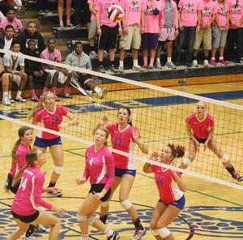
BSS – JAGUARS - HS Volleyball
High School Sports
Opportunity through COMMUNITY Investment

Slide 15
Factors Considered for Team Selection
Fall 2013
What’s the BEST for the team?
Who’s the Best Athlete/Player?
Numbers vary year to year according to:
Ability: - Athleticism
Character: - who you are as a person
Skill Development: - passing, defense, hitting, blocking, serving, etc.
Seniors
Juniors
Sophomores
Freshmen

Slide 16
BSS – Volleyball Teams
2013 – Freshmen (2 Teams)
2014 – JV (2 Teams merge into 1 JV Team)
2015/2016 (JR/SR – Merge into 1 Varsity Squad)
*Occasionally FR/SO will also have roles on the Varsity
As an athlete ages
Participation/Recreation Competition/Commitment
We encourage and support Freshmen athletes to participate in other school activities. The time to specialize is different to everyone. We acknowledge that this time may come for VB after the freshmen year.

Slide 17
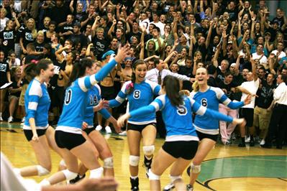
HS Volleyball – Purpose
High School Sports
Opportunity to grow through COMMUNITY Investment

Slide 18
HS Volleyball
Community Investment
Coaches salary – covered by district
Team travel to matches/tournaments – covered by district
Officials fees – covered by district
Uniforms – covered by district
Practice/Gym time – covered by district
Parent/Athlete Costs: Some equipment, sports physical, meals, admission at matches/tourneys, etc.

Slide 19
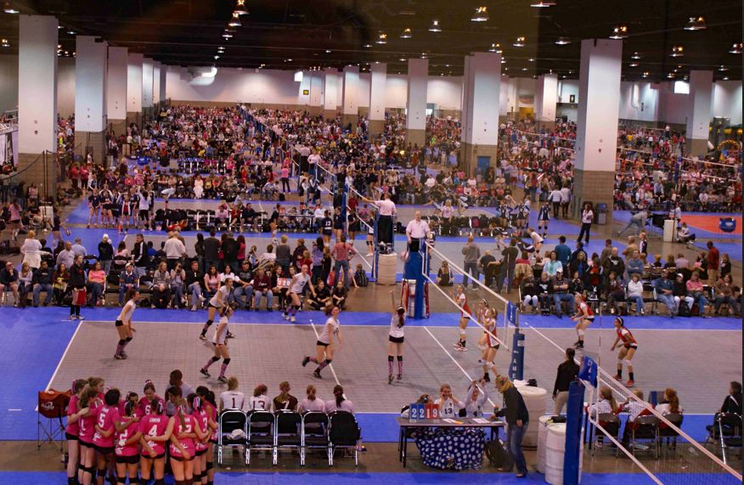
Club Volleyball – Purpose
Club Sports
Opportunity to grow through INDIVIDUAL Investment

Slide 20
Club Volleyball
Individual Investment
Coaches salary – covered by participants.
Team travel to matches/tournaments – covered by participants.
Uniforms – covered by participant.
Practice/Gym time – covered by participant.
Officials fees – typically no cost unless major tournament.
Typically – typically no cost unless major tournament.
Parent/Athlete Costs: Most equipment, membership fee, meals, travel, coaches fees.

Slide 21
High School VB Cont.
You may feel your daughters best chances for college volleyball are to play a certain position. You may be correct but that is not our primary focus. Our objectives are found in our mission. Our goal regarding volleyball is to win a State Championship with the players that live in our community. Your daughter will be asked to do what the coach feels is best for the team, program & school. We assist in the college process but it’s not our main objective.
Your daughter may be trained to play a position that they don’t always play in club. These decisions are made by the coaching staff and will be communicated with your daughter.

Slide 22
HS Volleyball vs. Club Volleyball
CHOICES (So, you want play volleyball)
High School: Limited amount of choices for participation.
Clubs – (KC Metro Area) Multiple options & choices for participation.

Slide 23
BSS – Volleyball
Our main objective is not necessarily to get players to college. However, it is fortunate is that college coaches want athletes from successful HS programs. Overall, these athletes understand and have experienced loyalty, commitment, community and school pride.
We do not recruit players for positions of need.
We fill our needs with the talents of those who walk through our doors or we develop our own to meet our needs.

Slide 24
SOUTH PLAYERS - PLAYING CLUB VB

Slide 25
Club VB & BSS VB
3 types: (Competitive, developmental, recreational).
Club VB is not required to be a member of BSS HS VB.
We do not endorse any one club over another.
We do endorse the quality of a coach and development of skills vs. recreation.
We do endorse a high level of competition and high frequency vs. recreation.

Slide 26
Summer - 2013

Slide 27
Summer - Freshmen
Team Philosophy/Rules/Expectations Apply
Contact with coach – same as in season (24-72 Rule)
HS – expectations – players manage their schedule & roles. Players communicate with coaches about concerns before parents do. Players are expected to set up and take down, are assigned roles pertaining to facilities/equipment.

Slide 28
Summer - Freshmen
Team Philosophy/Rules/Expectations Apply
Contact with coach – same as in season (24-72 Rule)
Mini Camp 5/29 & 5/30 (4pm-6pm)
- $55 (Use July Camp Registration Form) (One cost both camps)
Bus will pick students up from MS
LSN League (Can’t take everyone)
Additional Cost
Being asked or not being Asked to participate in a Summer league does is not an indication of FALL 2013 team placement.
Playing time is not guaranteed – up to the coach.
Player may move in-between teams (F/JV/V)

Slide 29
Summer - Freshmen
AM Weights/Athletic Training
Open to all Freshmen – see website for dates/times (3xweek)
Summer Sand League (Thursday AM)
- $40 (Separate Registration Form)
Registration won’t be accepted until 5/8/13 - Wednesday
First come first serve – Players pick partners. If absent must find sub. Both players must register to hold team spot.
July Camp: Registration for Mini Camp includes July Camp – If interested in HS Fall VB – make plans to attend.

Slide 30
TRYOUTS

Slide 31
Tryouts & In-Season - Freshmen
5.11.13 – Pre-Cut Parent Meeting
5.12.13 – Tryouts (3-4 Days)
MUST HAVE PHYSICAL – Forms Available Tonight
PM Tryout Schedule – TBA – See Website
If someone is not offered a playing position in the Fall they may apply to be a manager or go out for another sport (Example: Cross-Country or Tennis)

Slide 32
In-Season - Freshmen
8.15.13 – 1st Day of School (Thursday)
8.16.13 – Post Cut Parent Meeting (Friday)
If a spot in the program if offered to your daughter and she accepts, there are many basic commitments that we expect:
Parents are expected/strongly encouraged to participate in VB Booster club endeavors. These activities include but are not limited to: Working concessions, line judging, hospitality rooms, team snacks, plan parties, assist with fundraising, serve on committees for special events(Senior night/DigPink/Banquet/etc).

Slide 33
www.bluespringssouthvolleyball.com

Slide 34
Schedule --- Click on item

Slide 35
Click on each item for more details

Slide 36
Checklist – End
[] Mini Camp/Summer Camp Registration Form
[] Summer Sand League Registration Form(WED)
[] MSHSAA Physical and Information Form
[] Poker Nigh Fundraiser Form/need players/sponsors
[] Text caster JAG New form – instant text alerts
[] Handout of Power Point –will be on website
[] Parent/Coach Communication Policy-Contract
Turn in to Coach Campbell - TONIGHT
[] Contact and Personal Information Form
Turn in to Coach Campbell – TONIGHT

