Slide 1
Brook Baseball
Parent Meeting

Slide 2
Coach’s Corner
Thank you to Will Ballard from New Hope Church for providing dinner.
Wife- Alexandria Ballard
Kids – Titus (2) and Maverick (1) Ballard
Coaching Expectations
Classroom Expectations/Student Code of conduct
Parent Expectations
Support program and all CCISD staff
Game Etiquette/UMPIRES

Slide 3
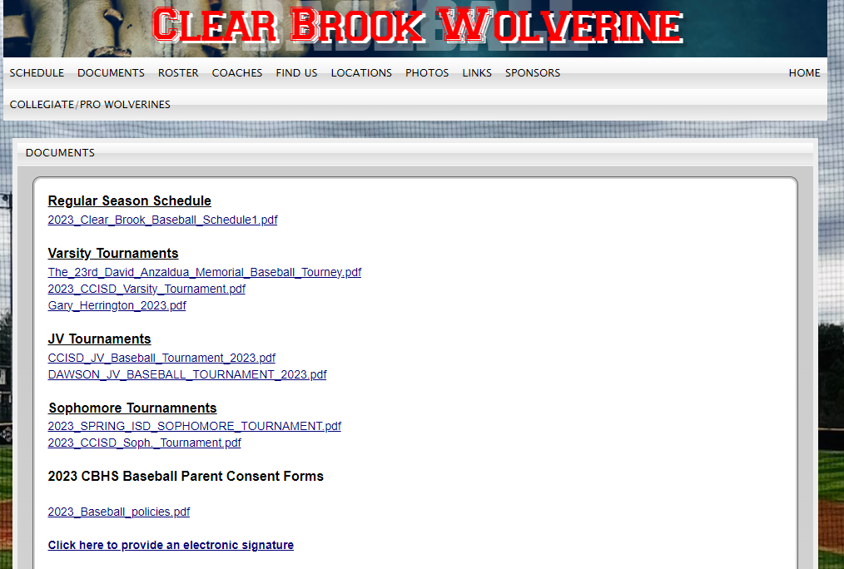
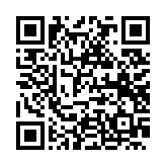
Forms & Communication
Electronic signatures for player packets are due Friday, February 3rd. The forms and electronic signatures are located at www.clearbrookbaseball.com under the documents page. Both player and parent are required to provide an electronic signature.
Sign up for the Sports You App to receive communication from coaches.

Slide 4
Parent/Player Important Information
Parent/Player workday is scheduled for January 28th or February 11th, pending weather.
Power washers are needed
Cage Lights and Nets
Load Concessions
Team pictures are still TBD
Senior Banner Photos will be Thursday Jan. 25th at 5:30 pm at Rhonda Floyd Photography (This will include Media day as well)
Concession stand duty – TWO options
Signup for two shifts
Buyout to pay for a volunteer (75$)

Slide 5
Parent/Player Important Information
Supplies required – Due February 3rd
Freshman
bring 3 bottles of SHOUT
24 pack soda and 18 pack 20 oz. Gatorade/Powerade
Juniors
one box of powder oxy clean
1 box individually packaged chocolate candy (18+ count)
1 box assorted chips
Sophomores
bring 3 bottles of SHOUT
2 boxes of individually packed non-chocolate candy (18+ count)
Seniors
one box of powder oxy clean
1 box individually packaged chocolate candy (18+ count)
1 box assorted chips

Slide 6
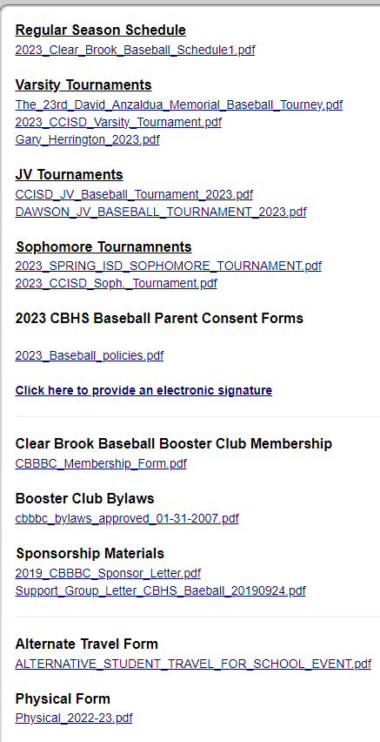
Schedules, Game Meals, & Transportation
Schedules for games are posted online.
Please be very flexible with players moving up and down.
Pending our fundraiser, we will provide meals for traveling tournament trips.
Won’t apply during district unless it’s the out-of-town Brazoswood game.
If a player is unable to use provided transportation by team, an alternate transportation form must be provided & approved by coach PRIOR to the game.
Form is available on website under documents.
Player must sign out after each game if traveling with a parent or guardian.

Slide 7
Practice Uniforms
Practice uniform will consist of grey or white pants and a red Brook baseball shirt. Stirrup pants are permitted. Cold weather gear is provided and expected to be worn during inclement weather. 73 Degree rule for sleeves.
No white socks allowed under uniform. Must be RED or BLACK, pending uniform color.
Purchase BOTH RED/BLACK belt and socks from any sporting goods store.
Players must purchase at least 1 red Brook baseball shirt and 1 pair of Brook baseball shorts. ($30 a set)
Players are assigned 1 hat. Replacement hats are $35.
Letterman jacket sizing for varsity players will be after the season is completed regardless of grade level.

Slide 8
Injuries & Academics
Report any injuries to Coach Tran or Coach Reyes BEFORE going to a doctor.
Dr. visits will almost guarantee time off and you will need a clearance note to participate in any physical activity.
Trainers can also help coordinate an orthopedic visit if necessary.
CCISD insurance may be purchased through the district.
Steve Tran 281-284-2166 stevetran@ccisd.net.
Ayana Reyes 281-284-2166 ayreyes@ccisd.net.
Tutorials are every day during Quest Hour lunch.
Players are REQUIRED to be at practice. Do not schedule appointments during practice time.
If a special circumstance arises, contact your coach PRIOR to the practice/game conflict.

Slide 9
During Season
Saturdays are planned practice days until further notice.
Pitching lessons during the season are prohibited. Hitting/Catching/Defense are encouraged.
Participation (including practice) on any outside team during the season is not allowed.
Do NOT make any plans during spring break! We start District Games that week.
Games are not played on GOOD Friday unless forced by weather.

Slide 10
Contacting Coaches
Preferred method is email. Please allow 24 hours for a response.
Never approach a coach after a game (especially after a loss), unless it’s a medical emergency.
Coaching from the stands will not be tolerated. This includes speaking to players near the dugout areas, hollering to grab player’s attention.
Coaches will not discuss playing time with a parent. Players should initiate this conversation and an open line of communication with player and coach is encouraged. Player will relay communication to parents.
Concerns other than playing time, please make us aware immediately. We will gladly assist or meet. However, meetings should be productive.

Slide 11
Social Media
Please share game pics with our webmaster, Mrs. Jefferies.
Email images to gjefferi@gmail.com
If you would like to see something Tweeted, please share with any of our coaches and also include Mrs. Jefferies. She will run most of our social media.
Our Twitter (X) handle is @Baseball_CBHS
Monitor your player’s tweets and all social media pages.
College coaches rely heavily on this for recruiting.

Slide 12
Spring Sponsorship & Fundraisers
Vertical Raise- We will start this on Friday, bring in 20 emails and phone numbers of family and friends.
Spring Programs- will be sold at the concession stand during regular season games. Full, half, and quarter page ads can be bought. Blitz Day information will come in the next weeks.
Sponsor levels for businesses- see form

