Slide 1

EKRC Coach’s Binder
Majors & E-Majors
Baseball

Slide 2
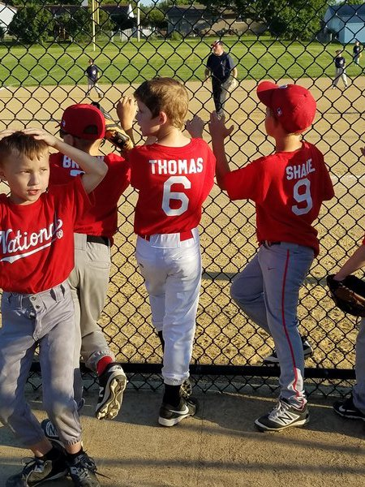
Majors & E-Majors
Coaching Binder
Guidelines
1. The newer aged kids don’t have the attention span for long practices or long speeches. They respond better to “steps”, rather than long explanations on form and mechanics.
2. Keep practices to 2 hours max.
3. Plan short drills with many repetitions in stations.
4. Every ball player should be doing something at all times.
5. End practice with a fun activity or ice breaker to build the bond of the team.
6. Never display negative criticism, frustration, abuse or anger.
7. Involve parents! Teach them what you are doing and why.
Goals
• Learn duties of all positions
• Learn situational baserunning
• Teach sportsmanship and what it means to be a team
• Proper batting stance, approach at the plate.
• Proper approach on defense, kids should be ready for the ball to come to them and know exactly what their job is.
Continue working on arm strength.
Pitching Mechanics: Continue to grow in learning the Wind-Up and the Stretch.
• General concepts of the game of baseball: These players should be ready to play in Jr High and Highschool baseball.
Other important information can be found on the EKRC Website! We look forward to having a great time playing the game we love!

Slide 3
Majors & E-Majors
Coaching Binder
Communication
• Communication with players and parents is a key role for the coach! Many different options out there to keep communication lines open: Group Text, GroupMe App, Heja App. Use whichever you feel most comfortable with!
• Communication with your Commissioner is also key! There will be coach check-in meetings with your commissioner through out the year, for you to ask questions, offer ideas and suggestions you may have. Your Commissioner is your first step of communication when it comes to EKRC.
Keep it Fun
We want kids to continue playing baseball. We do that by teaching the game and making it fun and rewarding throughout the year. Examples:
• Create a team mascot or “rally” object for games and hang it on the fence or dugout.
• Be an advocate for your players, grow the relationship. Players will attach to you, let them know your proud of them.
• Join them in stretching, jogging exercises, drills and games.
• Introduce game captains. (Two is a good number) Designate the captains and give them responsibilities, like consoling players that get upset, rooting for players, or keeping track of lineup. This teaches leadership.
• Game Balls - Write on the baseball: your team vs the other team, the year, coaches name and a nickname you have for the player. The older kids will still get a kick out of this!
Other important information can be found on the EKRC Website! We look forward to having a great time playing the game we love!

Slide 4
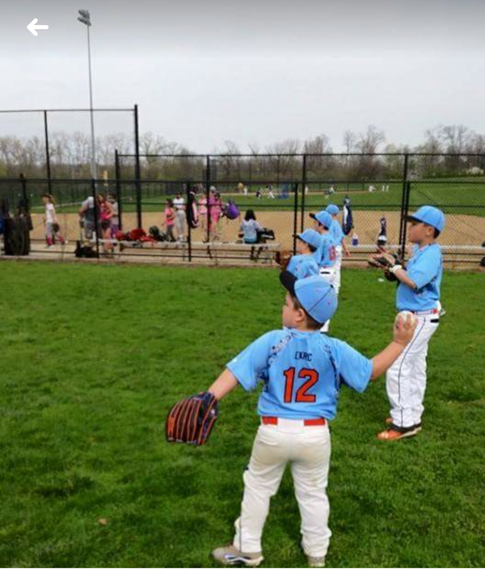
Throwing
Throwing Safety
Teach the players during warm-ups that you do not throw a ball unless you see a target presented by the other player. Teach the receiving player to give the thrower a target (glove and open hand). Coach should have complete control over every warm-up throw during the first few practices if possible.
Throwing Form
Continue to help teach throwing mechanics and growing the arm strength. You will have some players that are advanced, but you will also have some kids that will need the extra coaching to continue to develop.
Basic throwing form may be taught as follows:
• Use glove hand to point to throwing target (aim).
• Teach three positions of the throwing arm. DOWN, BACK and THROUGH.
• DOWN- Bring the ball down past the right thigh.
• BACK – Ball facing away and reaching back away from the target forming a “L”
• Introduce 2 seam and 4 seam grips, this will help the kids have more control of the ball leaving the hand.
Throwing Drills
(Works really well as 4 stations, to keep all of the kids busy at the same time)
• Target Practice Drill – Have hula hoops or other markings for target practice! Have fun with it, put it in different areas around the fence, have the kids start close and continue to back up.
• Perfect Passer – It’s a game of 21. You have the kids in pairs of two, have them challenge each other with glove placement. If they can hit the target with out having to move the glove, that’s a point!
• Situational Throws – Have the kids in the field and teach them the correct play to make.(Outfield – throw it to second, etc.)
• Long Distance Toss – Have the kids pair up and start working on growing their arm strength. Practicing the crow hop. Pay attention to the pairings, make sure the two are close to the same skill level.
Crow Hop - Time to teach how to crow hop to our players. This works great for long distances. Teaching how to drive off the back leg, pushing momentum forward to throw the ball at a long distance.

Slide 5

Hitting
Hitting Safety
Establish very early on that NO PLAYER swings a bat unless a coach tells them to, and that no player holds a bat without a helmet.
Hitting Form
The goal of teaching hitting in Kid Pitch is to get the player comfortable swinging the bat with a ball being thrown and learning the strike zone. During games, many will feel deep pressure when hitting, some may even have some fear. We can ease this pressure by having them focus on simple steps for getting ready and balanced.
The early teaching points are as follows:
• Steps for plate approach are “FEET, HANDS, KNEES”
• First, “Strike zone”. This is simply teaching the strike zone and what pitches are the right ones to hit, we do not want to teach bad habits of chasing bad pitches.
• FEET – Focus should be on the toes and heels being parallel and pointing straight to the plate.
• HANDS – back hand should be on top of front hand and touching on the handle of the bat (no gap between hands).
• KNEES – Knees should be slightly bent and “athletic”. Teaching an athletic stance goes a long way in the sport of baseball.
Advanced Tips (Hitting) - Consider introducing advanced hitting abilities. Have the players going up to hit to the depending on where the ball is thrown. (Example: Outside pitch, hit it oppo. Inside pitch, Pull the ball.) This will teach bat control. Make sure they succeed in this not by moving their feet and body, but by controlling the position of the hands and barrel of the bat.
Hitting Drills
• Hit The Color Soft Toss – This is a drill where you can have different color dots on the ball. Throw two at a time and call out a color for the player to hit.
• Stationary Tee hitting – Have a set of 2 or 3 tees for the kids to have constant swings, hitting into the fence. You can place this is the three sections of the plate to teach bat control. (Outside pitch, Inside Pitch, Right down the Pipe.)
• Basketball Tee (Power) – All you need is a tee, semi deflated basketball, and a plunger. This will improve power. The players will have to drive their hands through the ball.
Live Hitting – Make teams of 3-5, have the kids play a continuous game like scrimmage. Each player gets two hits, then rotate each team from Outfield to Infield to hitting with a water breaks in-between.
Bunting – Another lost art of the game. Teach kids how to bunt! Teach the situations to lay a bunt down. Bunts can even help build a hitter’s confidence at the plate!
Other important information can be found on the EKRC Website! We look forward to having a great time playing the game we love!

Slide 6
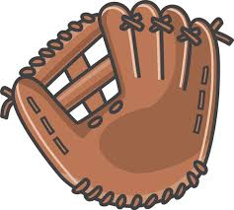
In-Field & Out-Field
Fielding Safety
Eyes always on the batter. Be sure to know the role of your own position.
Infield and Outfield Form
Continue to teach the “baseball ready” position.
• Knees bent with wide base (athletic stance)
• Toes pointing forward
• Flat back with glove hand out with palm up
• Field ball with glove and palm up and throwing hand palm down forming the ever popular “alligator”
• Point to target and throw! (common habit kids have at this age is that players throw flat footed or can even fall backwards. Teach throwing and moving toward the target.)
• Fielding Responsibilities! (Teach that each position is responsible for covering a certain part of the field.)
Infield Drills
• Golden Glove – This is a baseball version of knockout. Have the players have a certain area they have to cover, hit them ground balls, if they miss they are out. Its fun and gets competitive.
• Rapid Fire! – Have the kids have a line of about 5 players. Rolling grounders to the players, their job is to be as fast as possible to run the ball back to you. As soon as you get the ball back you roll another one to the next player. (This is a great one to get some energy out!)
• Side to Side Cone Drill – Put your player in the middle of two cones. Either hitting or rolling the ball, have them work on forehand and backhand plays.
• Perfect Game of 21 – This is a fielding scrimmage. You as the coach, will be hitting real situations to your team. Using ghost runners if it’s a base hit, etc. The goal is to record a Perfect 21 outs with out making a mistake. Depending on time, you could have the game start over when an error occurs. Have fun with this, make some of the situations tough.
Outfield Drills – Focus on Tracking a Fly Ball
Pop Up lines – Have them line up and work on catching a pop up in their glove, using the other hand over top.
Over the Head Receiver Drills – Line the kids up, and a coach is the QB. Players will run forward, Coach says left or right, then throws a pop up in that direction for the player to catch.
Side to Side Receiver Drills – 2 lines of players, one on the right of you and one on the left of you. You say go, throw the ball leading your receiver going to their left. Say go and lead your receiver running right. This is a rapid fire rotating drill. The kids will get in the other line after fielding.

Slide 7
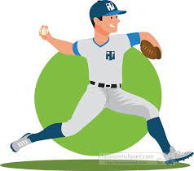
Pitching & Catching
Pitching & Catching Basics
Two of the most important positions our great sport has to offer. We feel that its best to teach everyone on your team to be able to do both positions.
Styles of Pitching:
Wind-Up – Players will use this when no one is on base or if the bases are loaded. Begin with both feet forward facing the plate. Sidestep with non throwing side foot, turn back foot against the rubber to push off, bring the front leg up, use momentum to fire a strike.
Stretch – Players will use this when runners are on base, allows the opportunity for a pick off play. Begin with the back foot against the rubber, coming set with both feet together and either a leg kick home, or a slide step home to release the ball.
Pitching Drills
• Bullpens – Have mini bullpen sessions with all of your players. This will allow them to work on the craft of pitching and getting comfortable doing so. More arms you have to put on the mound, the better off your team will be.
• Pick Offs – Take time to teach your entire team the arts of the pick off. Step off throw to first, jump spin or leg kick spin to second, or even a leg kick move to third. Pick offs will help keep baserunners honest.
• Pass ball Drills– It’s a quick drill to run, but it is very important to teach on a pass ball, it is the pitcher’s job to cover the plate. Especially with a runner on third.
• Bunt Defense – Also very important to include in your practices. When your pitcher is having a great day on the mound and the other team is struggling to hit, most coaches will start to try and bunt. Teach pitchers how to defend it. Explain that typically they will be the first one to ball, giving reps of this at practice will make pitchers much more comfortable when it happens in a game.
Catching Drills
Blocking – Working on blocking form. Coach or other players will throw the ball in the dirt. The catcher’s job is to not only keep it in front of them, but pushing their chest forward and knees to the ground will allow the ball to stay within a area that is easier to find the ball. Can do straight up or side to side blocks.
Receiving Drills– Having a catcher get used to the position is a big factor. Having them in the crouch and just working on receiving the ball correctly. Focus here is working on being comfortable and repetitions.
Throw Downs– Showing the proper form for a throw down. Working on the transfer from catching, popping up, and driving off the back foot to throw to the target. Reps on Reps will help players get comfortable doing this.

Slide 8
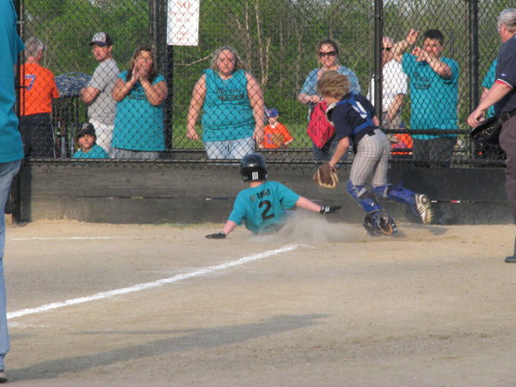
Base Running
Base Running
Teaching the basics of base running seems simple enough, until you get out on the field and notice how many players struggle with the little things like rounding a bag, how to stand on the base, etc.
Base Running Drills
• Lead offs – Teaching the players the correct way to lead off. Typically for most players it is good to have about 3 steps off of the bag. Watching the Pitcher’s back heal, if it raises you know to come back. It’s a step and dive to the back corner of the bag.
• Timed Trials Stealing – Have the kids line up, run first to second. Then second to third. Time them, allow the competitive juices to flow. Teaching the correct way to stand on the bag/ rounding the base form.
• Situational Running – Create scenarios where players will have to decide what the correct move is. This works great when having a group of players baserunning while playing a game of 21.
• Sliding – Teaching the proper way to slide is a necessity. Butt down, leg out, sliding mainly on your thigh. Practice makes perfect when it comes to this, and a lot of coaches haven’t had a lot of focus on this lately. You can also teach how to slide headfirst, but explain it will not be needed all the time. At this age level, you can also teach the players how to hook slide (Head first slide, snagging the back corner of the bag allowing your body to slide away from the tag.

