Slide 1

EKRC Coach’s Binder
Pony Ball & T-Ball

Slide 2
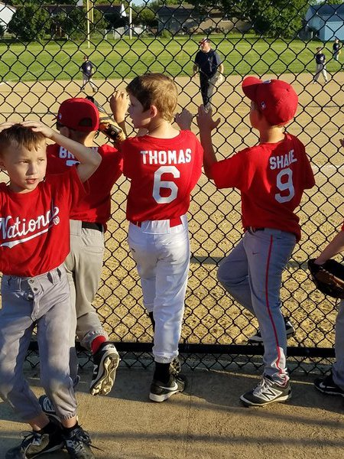
Pony Ball & T-Ball Coaching
Guidelines
1. 3-6 year olds don’t have the attention span for long practices or long speeches. They respond better to “steps” of three or less rather than long explanations on form and mechanics.
2. Keep practices to 1 hour 15 minutes max.
3. Plan short drills with many repetitions in stations.
4. Every child should be doing something at all times.
5. End practice with a fun activity. (sharks and minnows, red light/green light)
6. When talking to players, kneel so that you are eye level.
7. Never display negative criticism, frustration, abuse or anger.
8. Involve parents! Teach them what you are doing and why. The more the merrier when coaching the youngsters!
Goals
• Learn positions
• How to run the bases
• Teach sportsmanship
• Proper batting stance, approach at the plate, where to place the bat after a swing.
• Proper fielding stance, how to receive a ground ball, how to receive a pop up.
• Basic throwing mechanics
• General concepts of the game of baseball: Where to throw, where to run, and sticking to your position.
Other important information can be found on the EKRC Website! We look forward to having a great time playing the game we love!

Slide 3
Pony Ball & T-Ball Coaching
Communication
• Communication with players and parents is a key role for the coach! Many different options out there to keep communication lines open: Group Text, GroupMe App, Heja App. Use whichever you feel most comfortable with!
Communication with your Commissioner is also key! There will be coach check-in meetings with your commissioner through out the year, for you to ask questions, offer ideas and suggestions you may have. Your Commissioner is your first step of communication when it comes to EKRC.
Keep it Fun
We want kids to continue playing baseball. We do that by teaching the game and making it fun and rewarding throughout the year. Examples:
• Create a team mascot or “rally” object for games and hang it on the fence or dugout.
• Join them in stretching, jogging exercises, drills and games.
• Introduce game captains. (Two is a good number) Designate the captains and give them responsibilities, like consoling players that get upset, rooting for players, or keeping track of lineup. This teaches leadership.
• Game Balls - Write on the baseball: your team vs the other team, the year, coaches name and a nickname you have for the player. The kids love this!
Other important information can be found on the EKRC Website! We look forward to having a great time playing the game we love!

Slide 4
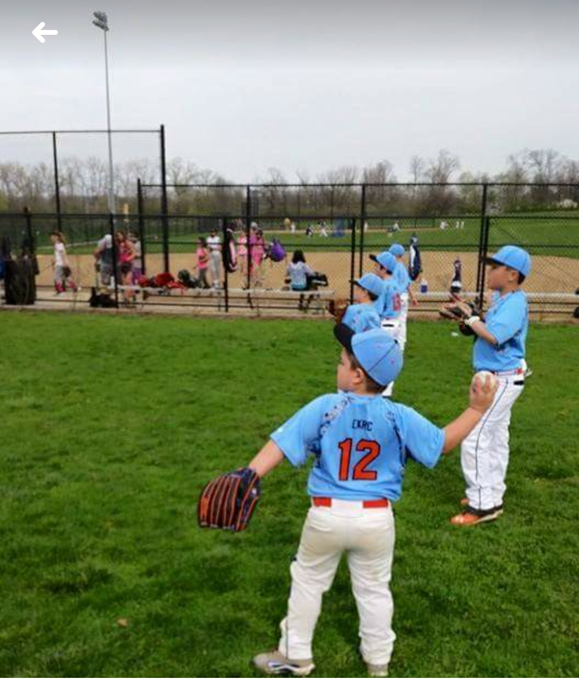
Throwing
Throwing Safety
Teach the players during warm-ups that you do not throw a ball unless you see a target presented by the other player. Teach the receiving player to give the thrower a target (glove and open hand). Coach should have complete control over every warm-up throw during the first few practices if possible. Line kids up and don’t have them throw unless on your command. Have tennis or rubber balls on hand in case you need them.
Throwing Form
This age is crucial for learning throwing mechanics. One of the most important teaching moments of the Tee ball season is playing catch in the beginning of practice. Basic throwing form may be taught as follows:
• Use glove hand to point to throwing target (aim).
• Teach three positions of the throwing arm. DOWN, BACK and THROUGH.
• DOWN- Bring the ball down past the right thigh.
• BACK – Ball facing away and reaching back away from the target forming a “L”
• THROUGH – Throw ball and have throwing arm follow through to non-throwing side knee.
• Grip – their hands are too small for a two-finger grip. We want to teach them to throw the ball off their fingertips eventually but this age they pretty much have to palm the ball.
Throwing Drills
(Works really well as 4 stations, to keep all of the kids busy at the same time)
• Hula Hoop/Beach Ball Throwing Drill – Have coaches hold hula hoops and beach balls for target practice! Have fun with it, put it in different areas, put it over your head, etc.
• Knock It Off Drill – Place a tee with a ball seated on it, have the kids try to hit the ball off the tee! Place an empty bucket, have the kids try to knock it over!
• Throws to first – Have the kids field a ground ball and make the throw to a coach standing at first base.
• Long Distance Toss – Have the kids stand in and focus on throwing the ball against the fence, continue to have them take a step back and do it again, see how far some players can make.
Other important information can be found on the EKRC Website! We look forward to having a great time playing the game we love!

Slide 5

Hitting
Hitting Safety
Establish very early on that NO PLAYER swings a bat unless a coach tells them to, and that no player holds a bat without a helmet. Teach dropping the bat (create a mark or circle for where the kids should drop the bat)
Hitting Form
The goal of teaching hitting in Tee ball is to eliminate bad habits and get the player comfortable swinging the bat. During games, many will feel deep pressure when hitting the ball. We can ease this pressure by having them focus on simple steps for getting ready and balanced.
The early teaching points are as follows:
• Steps for plate approach are “FEET, HANDS, KNEES”
• First, “Hit the Spot”. This is simply measuring the barrel of the bat up to the ball, giving the kids a target (using the logo is always helpful).
• FEET – Focus should be on the toes and heels being parallel and pointing straight to the plate.
• HANDS – back hand should be on top of front hand and touching on the handle of the bat (no gap between hands).
• KNEES – Knees should be slightly bent and “athletic”. Teaching an athletic stance goes a long way in the sport of baseball.
Advanced Tips (Hitting) - Consider using the Tee to introduce advanced hitting abilities to the more advanced hitters. Have the players going up to hit to the oppo side or up the middle, or pull. This will teach bat control. Make sure they succeed in this not by moving their feet and body, but by controlling the position of the hands and barrel of the bat. Also, consider setting the ball up on the inside of the plate, outside, etc.
Hitting Drills
• Follow the Leader – This really helps the kids break down a stance and swing, step by step. Have all of the player lined up a safe distance apart, helmets on and a bat. They will follow the leader(Coach) walking through each step of stance and swing. Again add in some twists to this to keep it fun!
• Station Tee hitting – Have a set of 2 or 3 tees for the kids to have constant swings, hitting into the fence. Works best if you have the same amount of players hitting as tees. Continuous swings will get the comfortability up.
• Side Soft Toss – Have 2 or 3 stations of soft toss from the side for the players to continue to get a good amount of swings (Hitting into a net or fence). This will be a challenge for the younger players, but it will be good for their development.
• Live Hitting – Make teams of 3-5, have the kids play a continuous game like scrimmage. Each player gets two hits, then rotate each team from Outfield to Infield to hitting with a water breaks in-between.
Other important information can be found on the EKRC Website! We look forward to having a great time playing the game we love!

Slide 6
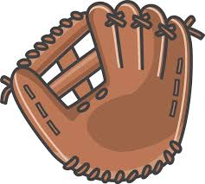
Fielding
Fielding Safety
Eyes always on the batter. Be sure to stay in your own position, you can give each kid an imaginary triangle of where they can field the ball when hit (can help eliminate collisions).
Infield and Outfield Form
The most we can get out of Tee Ballers is to have a proper “baseball ready position” and glove positioning fielding the ball.
• Knees bent with wide base (athletic stance)
• Toes pointing forward with glove hand foot slighting in front of right
• Flat back with glove hand out with palm up
• Field ball with glove and palm up and throwing hand palm down forming the ever popular “alligator”
• Point to target and throw! (common habit kids have at this age is that they throw flat footed or can even fall backwards sometimes. Teach throwing and moving toward the target.)
• Fielding Responsibilities! (Teach that each position is responsible for covering a certain part of the field. Imaginary triangle)
Infield Drills
• Protect the Sandcastle! - Use a base as the “sandcastle” and it’s the players job to protect it from the ball getting to it. Mix up the pace of rolling ground balls to them, have them start on the left or the right (working on forehand and backhand).
• Rapid Fire! – Have the kids have a line of about 5 players. Rolling grounders to the players, their job is to be as fast as possible to run the ball back to you. As soon as you get the ball back you roll another one to the next player. (This is a great one to get some energy out!).
• Hungry Hungry Alligator! – Coach is in the middle of 4-6 players in a circle. Coach will randomly roll balls to players, they will have to use the “alligator form” to field it. Then keep their pile behind them. See who has the most at the end of the game! (Mixing in other types of balls can be fun for this drill as well)
• Position Quiz – Gather all the players together, ask them as a group to run to a position you call out (1st, Catcher, Left Field) have all the kids work together to find the correct position. Once they are correct, ask them what position and let them yell the position back to you! (If you have them say it 3-5, the easier it is for them to remember the next time you decide to quiz them.)
Other important information can be found on the EKRC Website! We look forward to having a great time playing the game we love!
Outfield Drills
• No Glove! – Use a softer ball (tennis ball, koosh ball) and have the kids work on catching the pop up with two hands.
• With Glove! – Start with a softer ball still, have them work on catching a pop up in their glove, using the other hand over top. (you can introduce the tball as kids get more comfortable)

Slide 7
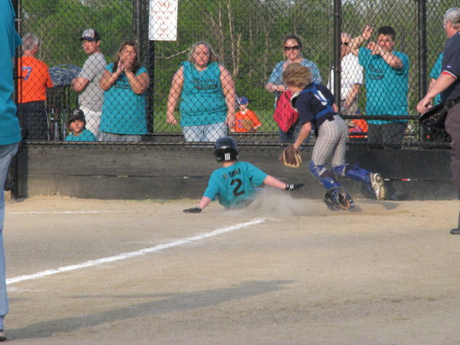
Base Running
Base Running
Teaching the basics of base running seems simple enough, until you get out on the field and notice how many players actually struggle on where to go next. Focus on teaching the players the proper 1st>2nd>3rd>Home cycle.
Base Running Drills
• Swing, drop, run! – Teaching the players where to drop their bat after the swing and running to first base.
• Base to Base! – Have the kids line up, run Home to first. First to second. Second to third. Third to home. Teaching the correct way to stand on the bag/running form when getting ready to move on to the next base.
• Relay Races! – Have 3 or 4 players to a base. On your mark, get set, Go! Kids will run and tag the next player at the base to and it’s a continuous relay from there.
• Sliding Practice – Teaching the proper form to slide! Extend the leg and slide, can be done on a slip n slide or cardboard boxes to get used to the correct form.
Other important information can be found on the EKRC Website! We look forward to having a great time playing the game we love!

