Slide 1
Huntington Beach High School
AthleticClearance.com Help Guide

Slide 2
AthleticClearance.com – Login Page
Electronic Database – Completely secure, enables us to access student information from anywhere in case of emergency

Slide 3
AthleticClearance.com – User Account
For Returning Users:
For New Users:
Login to your existing account
If you have forgotten your password, click on “Forgot Password” to reset it
If you don’t remember your login, you will need to create a new one and fill it out all over again
Register for an account
Use your email & select password
WRITE THIS DOWN AND SAVE IT!

Slide 4
AthleticClearance.com – Home Page
After you log in, all users (returning and new) will be taken to the home page
Since it is a new year, returning students will still need to start a new clearance from scratch – after that it will get A LOT easier
Select “Start New Clearance Here!” to begin

Slide 5
AthleticClearance.com – First Things First
To begin, you will be asked to input the year, school, and sport your student will be participating in
Some students will be playing multiple sports but for now, select the first sport they will be playing in
We’ll get into how to add to other sports later on
Submit when completed

Slide 6
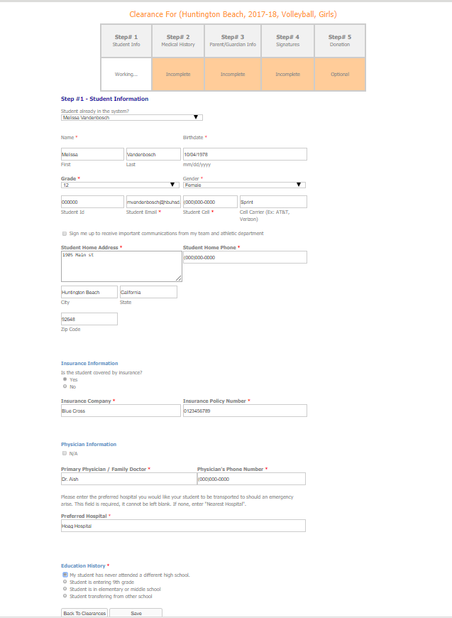
AthleticClearance.com – Step #1
Student Information
Complete ALL sections
Most problems occur in the “Insurance Information” section
ALL athletes must have insurance to participate in athletics/activities
Make sure you copy all of the letters and numbers in the policy number/id section
If you do not have health insurance, you can purchase school insurance by going to the following site: https://www.myers-stevens.com/New/enrollment-page/
Once purchased, print the confirmation page and turn it in during clearance date
Submit when completed

Slide 7
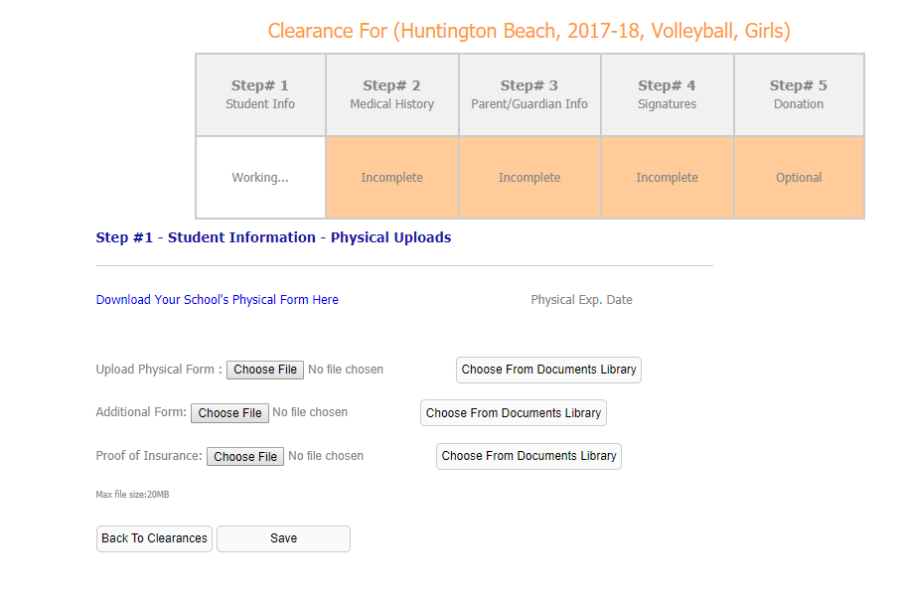
AthleticClearance.com – Step #1
Physical Upload Section:
If your student-athlete completed the HBHS physical in June at the school, we will upload the form for you after. Just click “Save” and move on to the next section
If your student-athlete completed the mandated HBHS sports physical elsewhere you must scan and upload the form in this section.

Slide 8
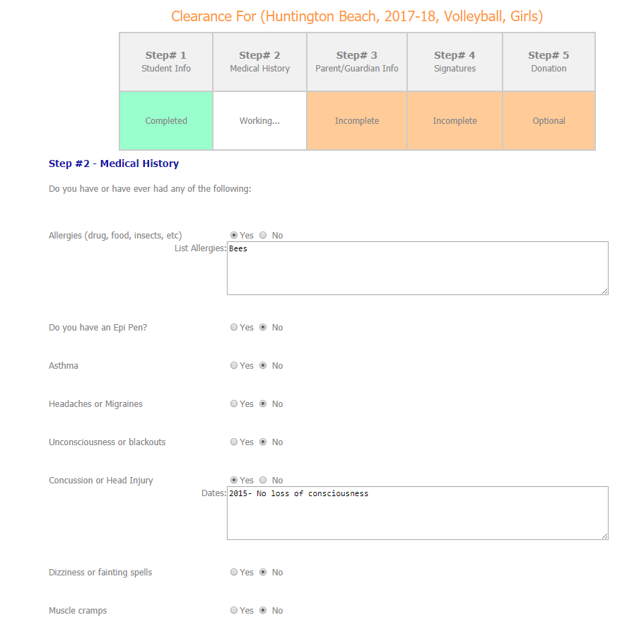
AthleticClearance.com – Step #2
Medical History
Complete ALL sections
When answering “yes” to any questions, you must fill in the boxes with more details
Submit when completed

Slide 9
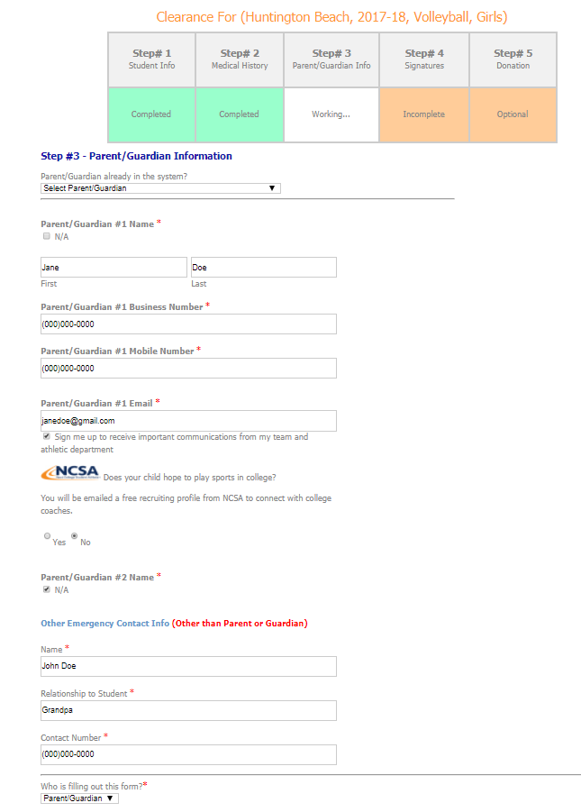
AthleticClearance.com – Step #3
Parent/Guardian Information
Complete ALL sections
In case of emergency, please input as many up to date phone numbers as possible so we may reach you

Slide 10
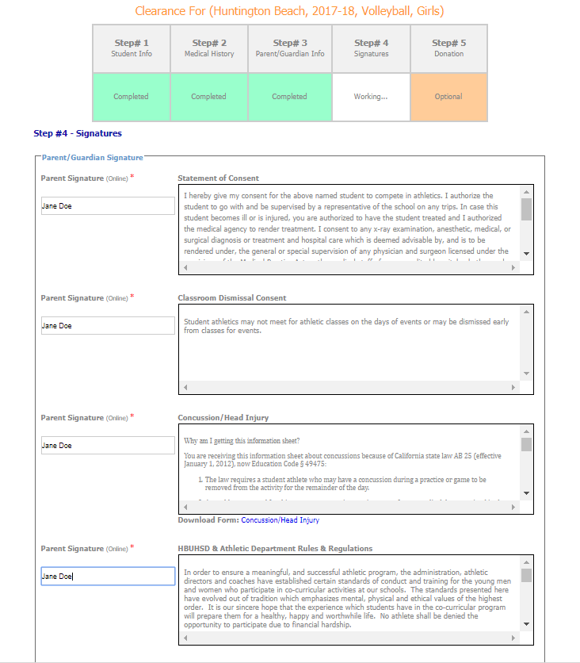
AthleticClearance.com – Step #4
Signatures – first portion will be for parent/guardian only
Complete ALL sections
Please read the material provided and/or download forms for your records
Parent/Guardians should be the only ones electronically signing their designated portions

Slide 11
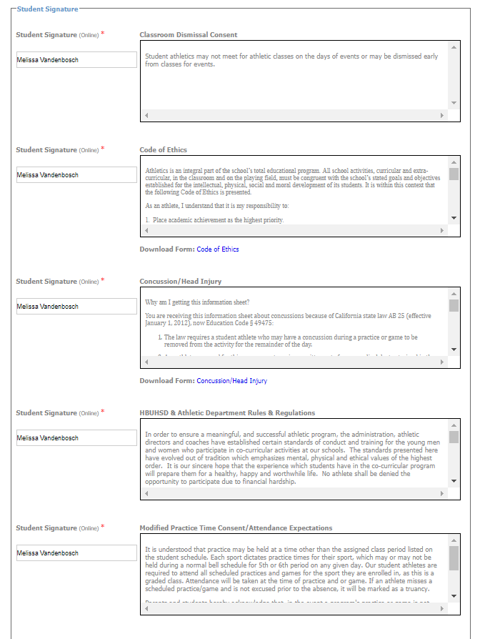
AthleticClearance.com – Step #4
Signatures – second portion will be for students only
Complete ALL sections
Please read the material provided and/or download forms for your records
Students should be the only ones electronically signing their designated portions
Submit when all signatures from parent/guardian and student have been completed

Slide 12
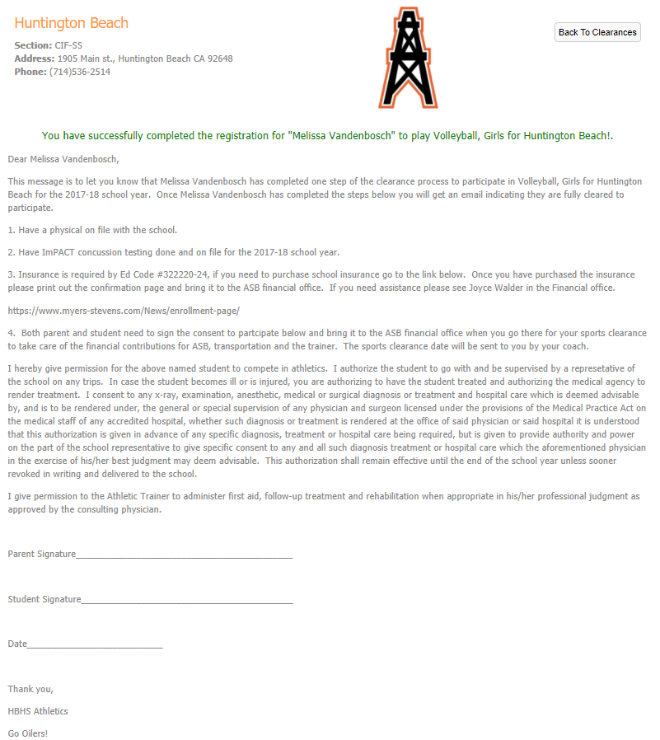
AthleticClearance.com – Confirmation Page
This page will appear after submitting Step 4
Print & sign this confirmation page and return it to school (Financial Office) for completion
At the Financial office you will take care of the financial contributions (ASB, Transportation, & Trainer)
An email confirmation will also be sent to the user account that can be printed at a later time if needed

Slide 13
AthleticClearance.com – Return to Home Page
Voila! After submitting the confirmation page, it will return you to the home page
At this time, you will be able to see the completed clearance

Slide 14
AthleticClearance.com – Finishing Tips
Keep your user email and password in a safe place!
After completing the first sport clearance, all additional ones should be a easy
Yes, you can add additional sports at a later time just as easily
Insider tip: If you want to add another sport at a later time, from the home page, follow the “Confirmation” column and select “View” from a sport from the CURRENT YEAR – this will take you back to the final confirmation page with the boxes you can select on the bottom. Mark any sport you would like to add, mark the acknowledge box, and submit! This will create complete files in all added sports.
Complete AthleticClearance.com ASAP – we input physicals, ImPACT, GPA, etc. on it and we cannot do so until this is completed

Slide 15
Questions?
Contact Athletic Director, Melissa Vandenbosch
Phone: (714) 536-2514 ext 4275
Email: mvandenbosch@hbuhsd.edu

