Slide 1
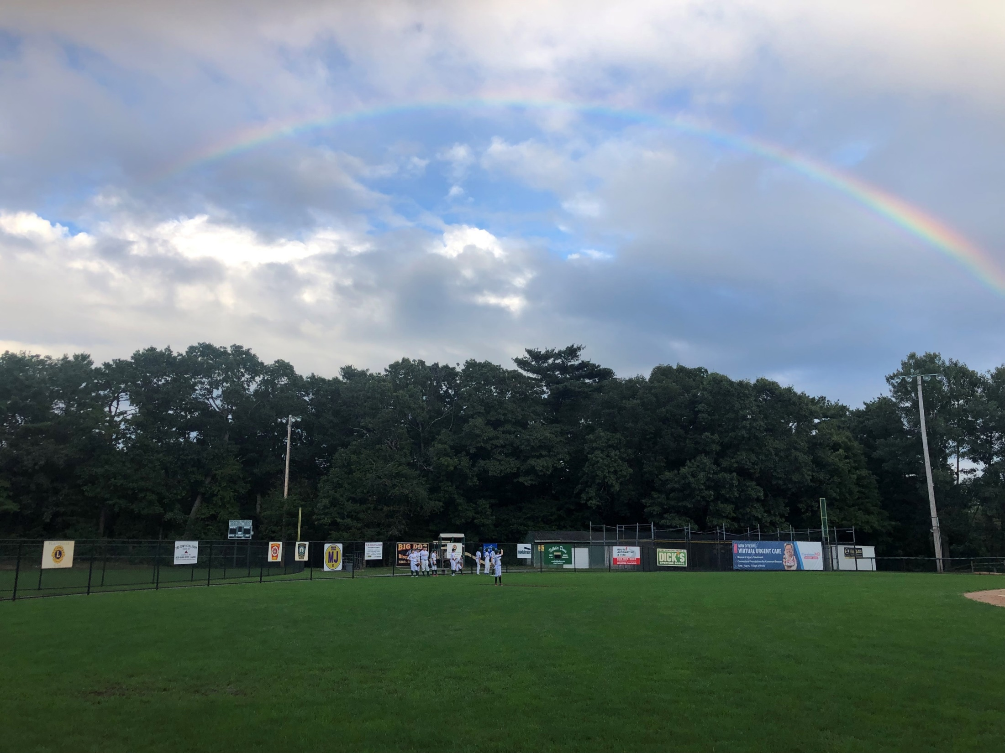

Plainville Athletic League
2026 Sponsor Prospectus

Slide 2
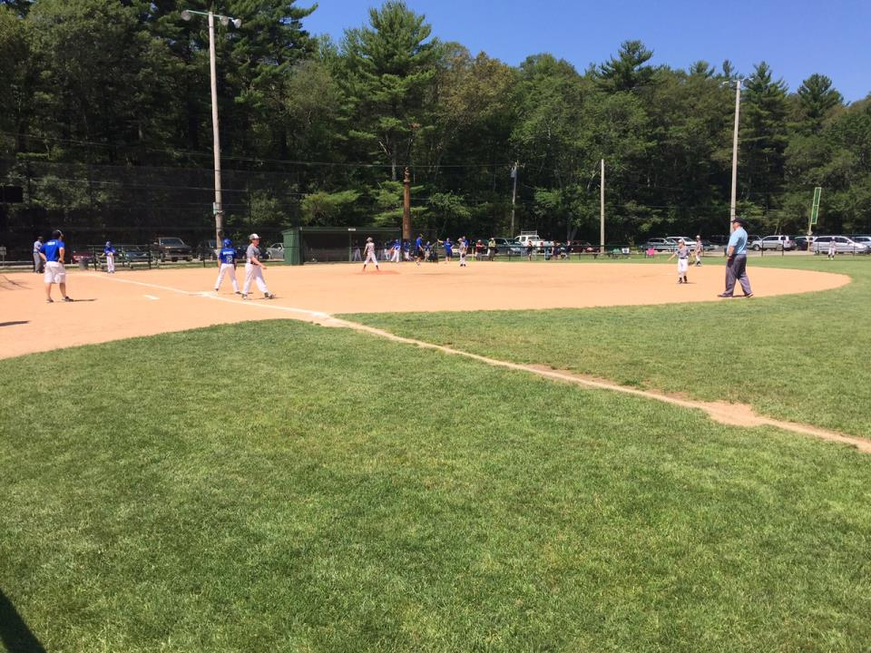

About the Plainville Athletic League
The Plainville Athletic League (PAL) is a youth sports organization that offers baseball for boys age 4 to 18 and fast pitch softball for girls age 4 to 16. Since 1955, the PAL has been run by parents and volunteers. We are a 501(c)3 nonprofit organization that is not funded by the town and therefore relies upon the generosity and support of its member families and local businesses in the community. The PAL is extremely proud of its long-standing policy to NEVER turn away a child due to a family’s inability to pay.
League affiliations include Cal Ripken and Babe Ruth Baseball as well as PONY, ASA, and Cal Ripken Softball. In addition to baseball and softball in the recreation season (April-June), we offer summer softball and baseball under our Tribe and Pride programs (June-July), fall baseball (September-October), and indoor clinics throughout the winter months as well.

Slide 3
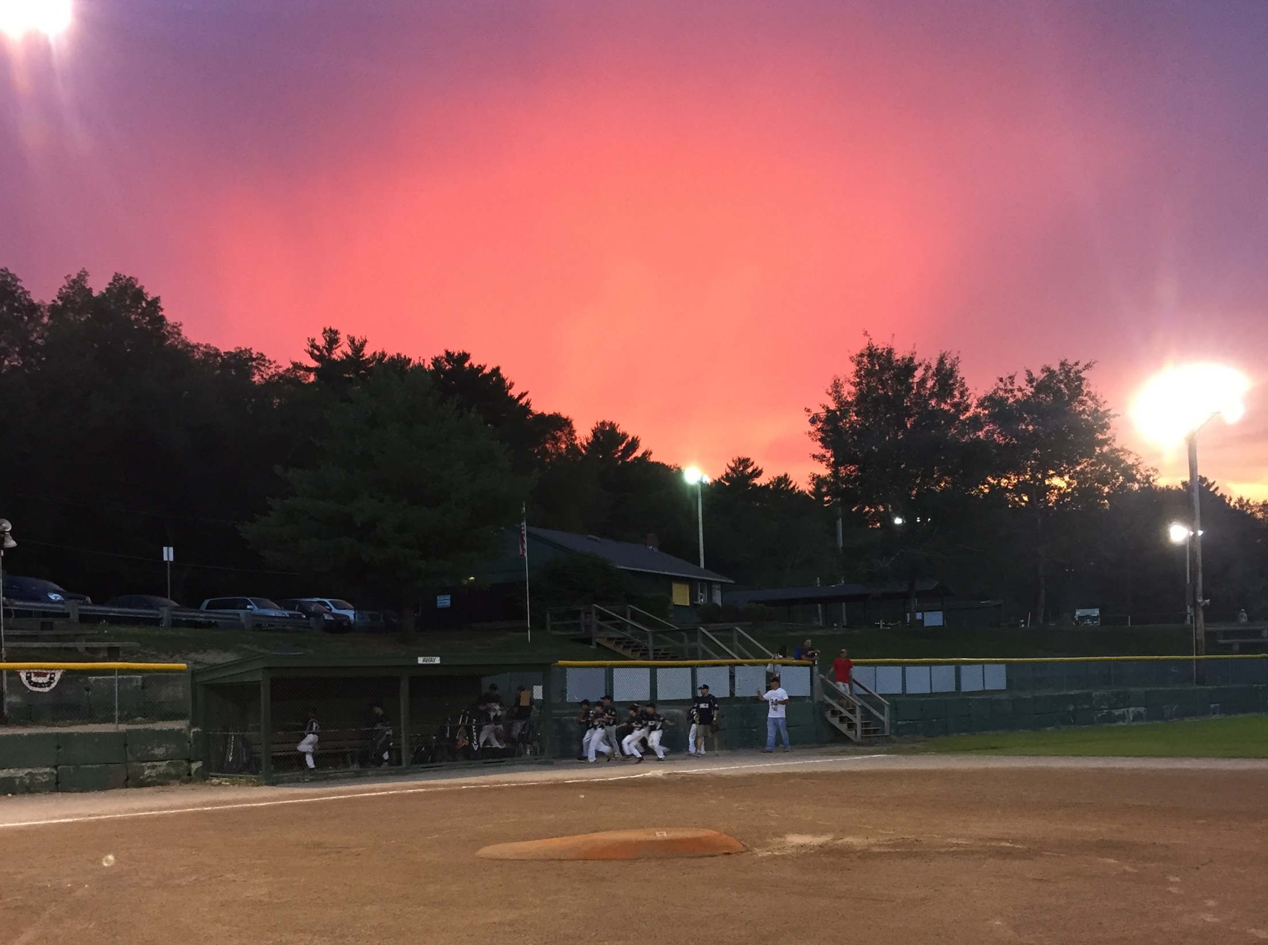





Sponsorship Exposure
Your exposure as a sponsor will go well beyond just the families of Plainville. Our complex hosts thousands of people from the surrounding communities as well teams and families from up and down the east coast from March through the end of October. Many of which spend time shopping, dining and looking for local services.
Our recreation season runs from late April through mid-June. During this time, we host teams from many surrounding towns as part our spring season. Additionally, our summer baseball program, the Tribe, and our summer softball program, the Pride, play over 50 home games between June and August, hosting towns from many different parts of Massachusetts.
We are the home of the 2010, 2011, and 2016 Massachusetts Division 1 MIAA State Champion King Philip Warriors softball program which brings teams from all over the region and state to our complex.
We are the home of the Rhode Island Thunder 18U fast pitch softball teams. Their tournaments and collegiate showcase bring approximately 175 college scouts, along with thousands of players and their families from up and down the east coast. These teams often stay within a 30-minute radius of the fields and patronize many of our sponsors.
We are the home of KP Pride softball. A club softball program for girls 10U-18U fielding travel tournament teams, with players primarily from Plainville, Wrentham, and Norfolk, MA recreational programs. They host several tournaments including the April Fool’s Fest, Ed Keene Memorial Day Invitational Tournament, Columbus Day Clash and the Halloween Bash bringing thousands of people to our complex.

Slide 4
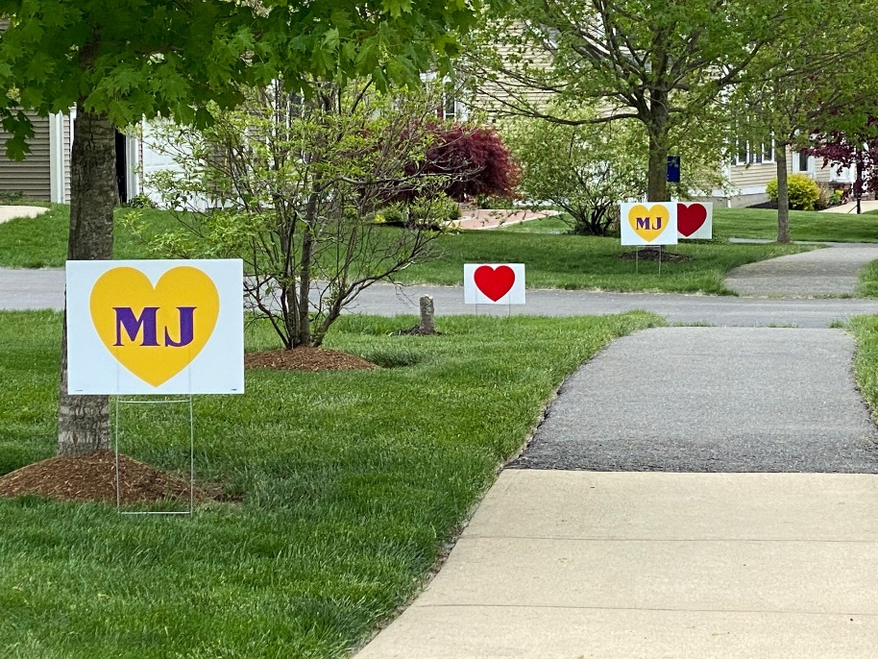


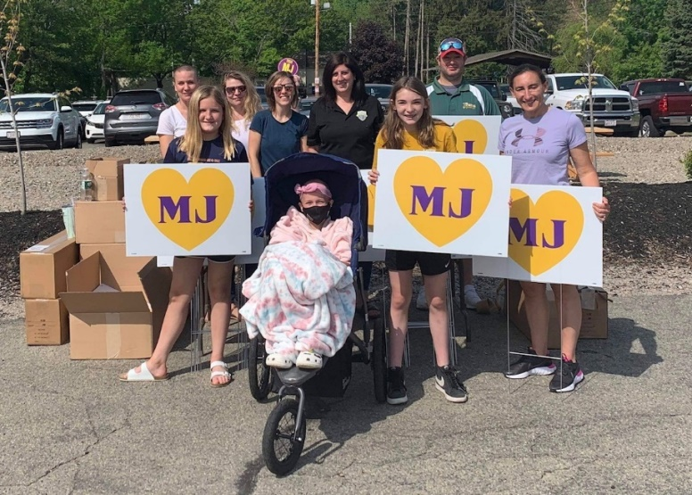
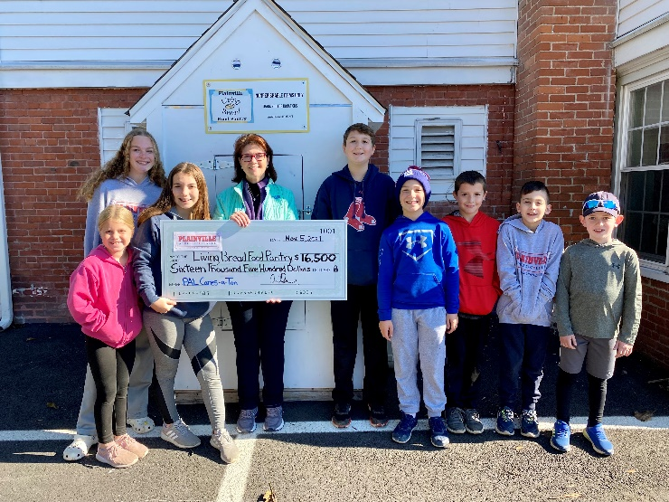
Giving Back to the Community
The scope of the PAL goes well beyond the field. While we are here to provide baseball and softball programs for the kids of Plainville, we pride ourselves on our community involvement as well. Over the years we have participated in a number of charitable endeavors which has included support of breast cancer and childhood cancer awareness, fighting children’s muscular dystrophy, and food drives.
our PAL Cares-a-Ton program raised $16,500 in 2021
in support of the Living
Bread Food Pantry
In 2021 we partnered with other local organizations to help raise over $20,000 in support of Malia
Jusczyk and their family’s foundation

Slide 5
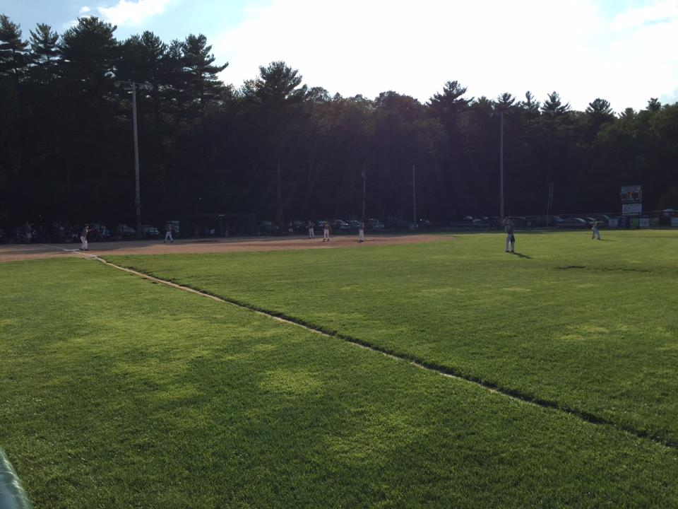

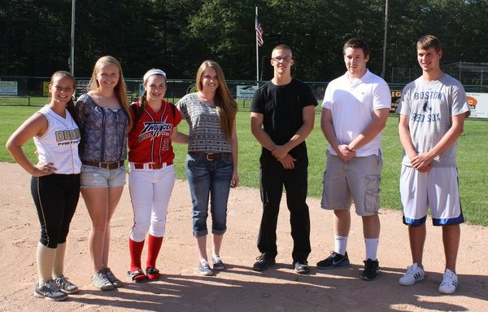
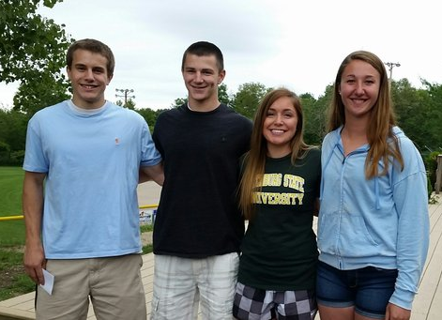
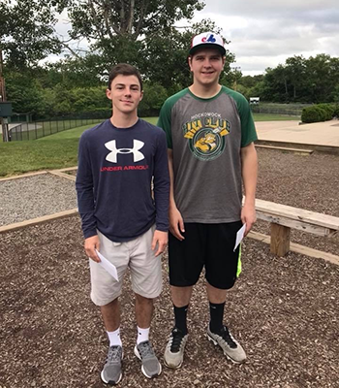
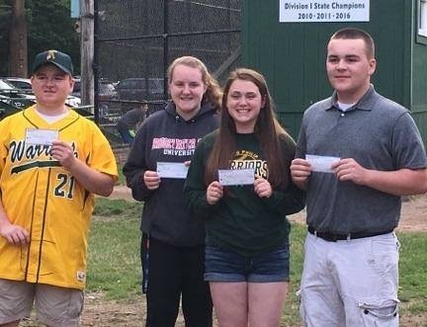
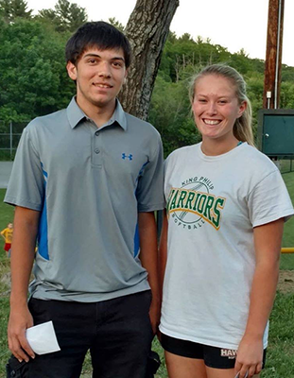
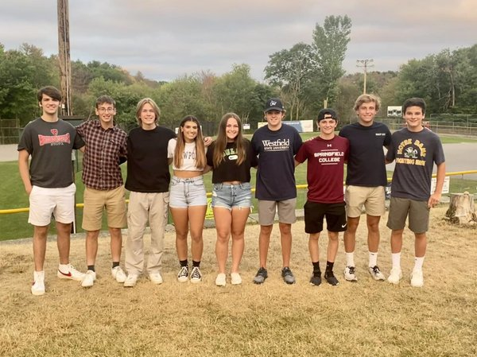
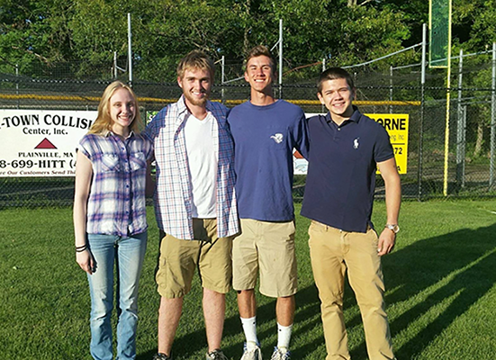
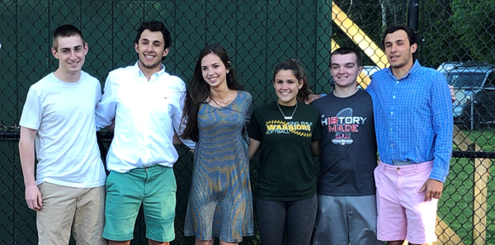
Supporting our Alumni
The Plainville Athletic League (PAL) is proud to award scholarships for PAL alumni who have attended a local high school and are planning to continue their education at a vocational school or college, two-year college, four-year college or university, or have enlisted in a branch of the US Armed Forces.
Since 2004,
the PAL has handed out scholarships to:
Over 100 alumni, totaling
over $65,000

Slide 6
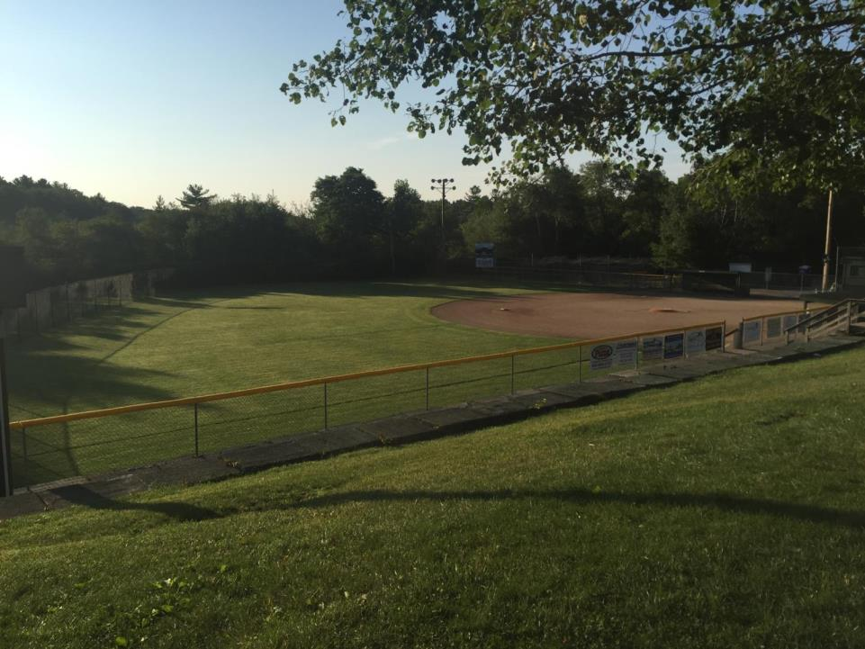
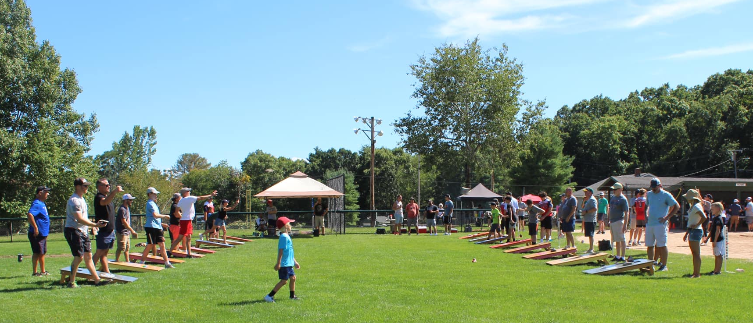
Special Sponsorship Opportunities
Watters Dugout Sponsorship
$5000 (2 sponsorships available)
This special sponsorship can be paid over two years if desired
A large sign for your company will be placed on the back of dugout saying, “This dugout is generously sponsored by…”
Signs will face the street for maximum exposure whether games are going on or not
Sponsorship is for 4 years
Nelson Batting Cages Sponsorship
$5000 (2 sponsorships available)
This special sponsorship can be paid over two years if desired
A large sign for your company will be attached to the cages saying, “These batting cages are generously sponsored by…”
Signs will face the street for maximum exposure whether games are going on or not
Sponsorship is for 4 years
Cornhole Tournament
In August or September, we will host our cornhole tournament. There are a number of sponsorship opportunities for this:
Tee shirt sponsor (small logo: $150 or large logo: $250) – have your company’s logo displayed on the back of the tournament tee shirt that will be provided to participants
Court sponsor – $150 – have a sign with your company’s logo displayed at one set of cornhole boards
All sponsors will receive a public thank you as well at the tournament.

Slide 7
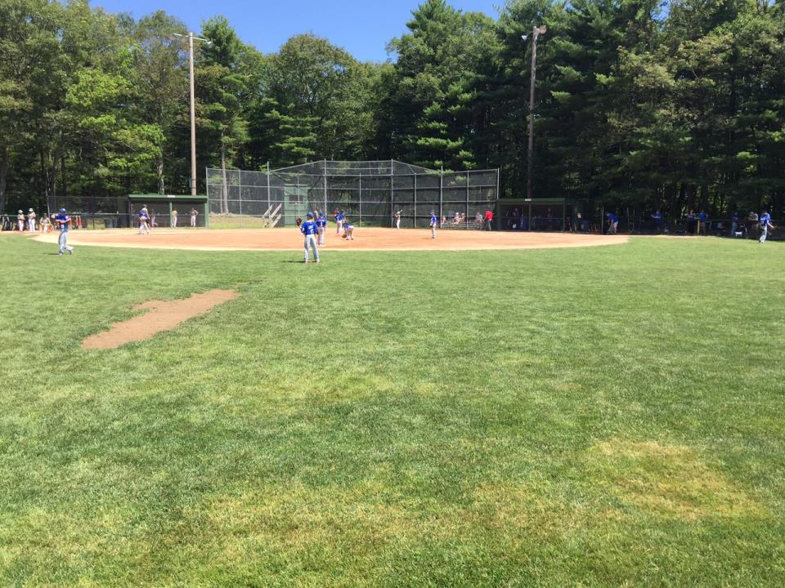
Traditional Sponsorship Opportunities
Grand Slam Sponsorship Package
$1300 ($225 in savings)
The grand slam package includes:
Two large field sign on Watters, Nelson, or Eisele ($1000)
Team Sponsor – Name on the back of a team uniform ($300)
Cornhole Tournament Sponsorship ($150)
Website Ad and Link ($75)
Sponsor Plaque
Home Run Sponsorship Package
$1000 ($125 in savings)
The home run package includes:
Two standard field signs on Watters, Nelson, or Eisele ($600)
Team Sponsor – Name on the back of a team uniform ($300)
Cornhole Tournament Sponsorship ($150)
Website Ad and Link ($75)
Sponsor Plaque
Triple Sponsorship Package
$600 ($75 in savings)
The triple package includes:
One standard field sign on Watters, Nelson, or Eisele ($300)
Team Sponsor – Name on the back of a team uniform ($300)
Website Ad and Link ($75)
Sponsor Plaque
Double Sponsorship Package
$350 ($25 in savings)
The double package includes:
One standard field sign on Eisele or Lewicki ($300)
Website Ad and Link ($75)
Singles Sponsorships:
Field Sign - $300 (standard), $500 (large)
Scoreboard Sign - $700
Team Sponsor - $300
Website Ad and Link - $75
Table at Opening Day - $50

Slide 8
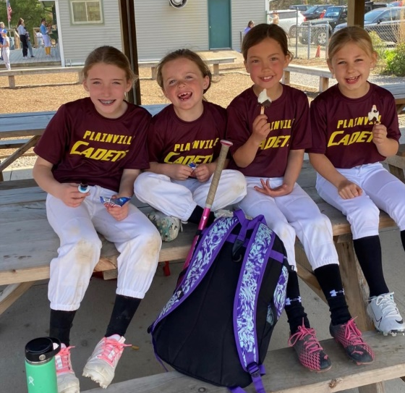
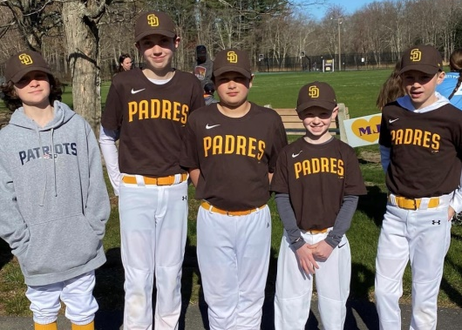
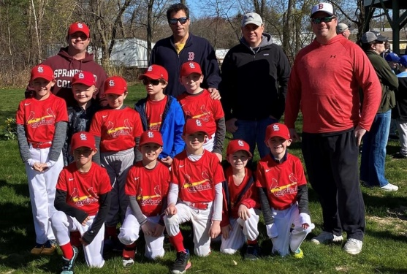
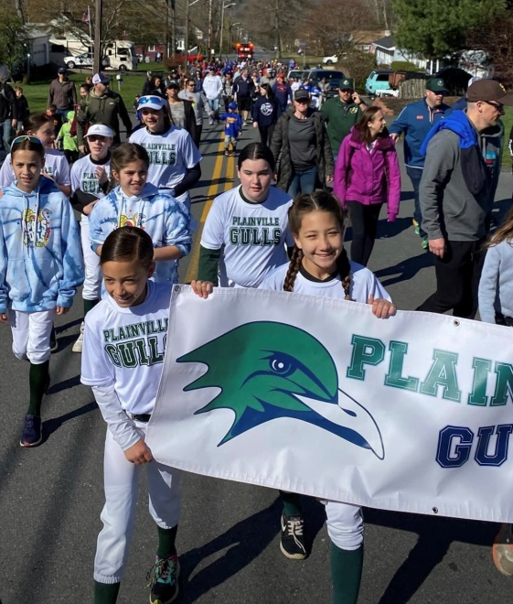
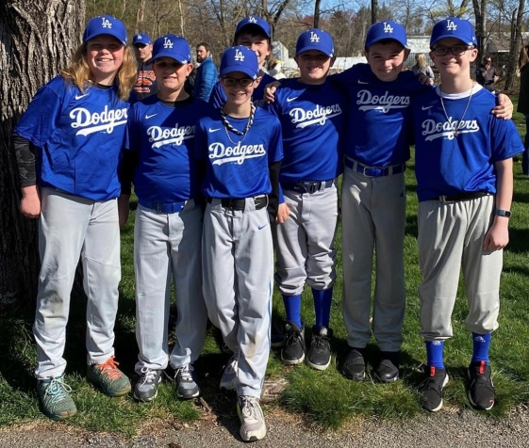
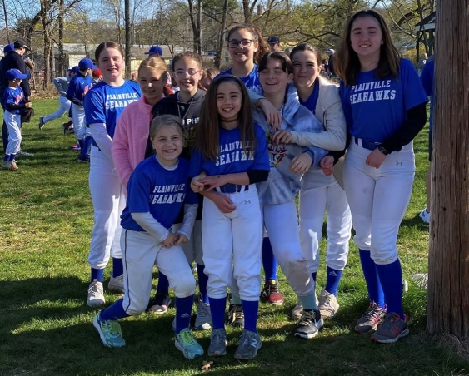
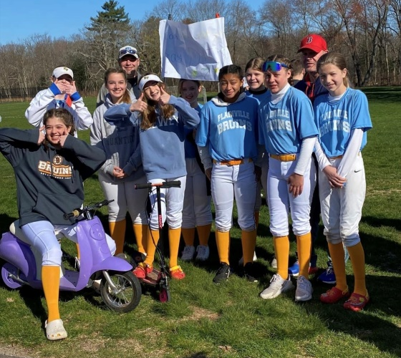
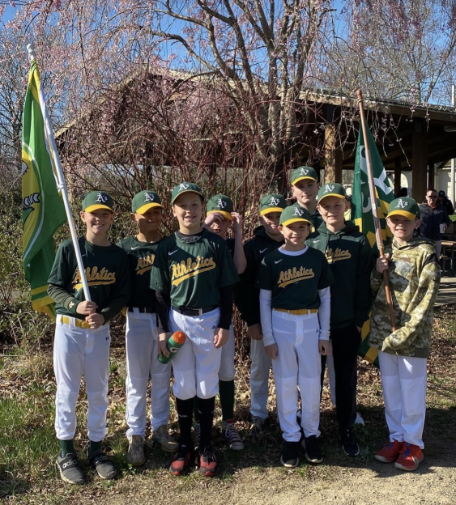
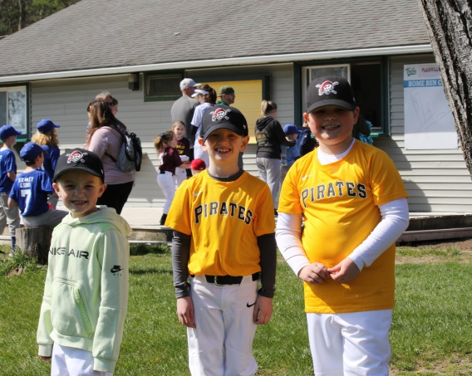
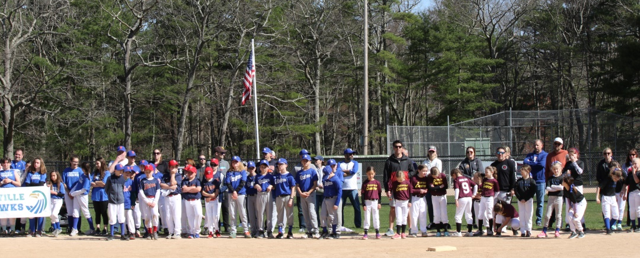
To discuss sponsorship opportunities, please contact us at:
palfundraiser1955@gmail.com
Or visit our sponsorship page.
Plainville Athletic League
Everett Skinner Road
Plainville, MA 02762
www.palonline.org

