Slide 1
Welcome 2018 RJB Families

Slide 2
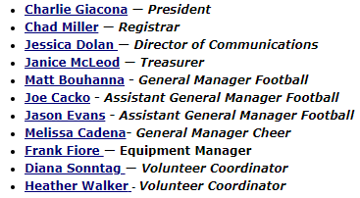
2018 RJB Board

Slide 3
Websites

Slide 4
Websites
www.romeojuniorbulldogs.com

Slide 5
OMYFA Rules

Slide 6
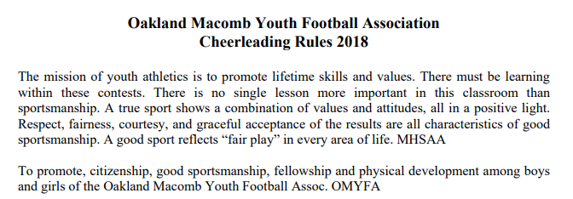

Slide 7
Cheer Rules
PARTICIPANTS
i.) Each participant must have practiced at least 2 out 3 or 3 out of 4 practices prior to performing at a game. Cheer teams may practice at different times than football, due to building availability, however all teams must maintain the no practice on Sunday policy or as stated in the OMYFA rules and/or may take one other day off

Slide 8
Football Rules
RULE 4 - PARTICIPANTS
Each participant must sit out for four (4) plays and have four (4) plays in each half. Kick-off and point after touchdown plays do count as plays. All special teams count as a play.
Each participant uniformed for a game must play at least four (4) offensive and/or defensive plays in each half. All dead ball fouls do not count as a play excluding after the play has been run. Participants ineligible to play must remove shoulder pads, unless the thirty-two (32) Point Rule applies.

Slide 9
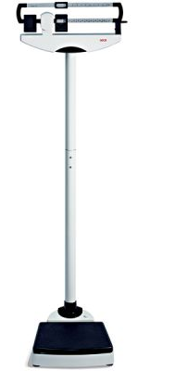
Rules
Squad | Age | Weight (lbs.)
Flag | 5,6,7 | -
Freshman | 8,9 | 125 120
JV | 10,11 | 145 140
Varsity | 12,13 | 170 165
Weight rules (NO EXCEPTIONS)
One time on scale
Varsity can weigh in during Flag game
Miss weigh in = no play
If injured still weigh in
Full pads & Fully dressed (no helmet)
Players have the option of a dry weigh-in (less 5 lbs overall).

Slide 10
Rules
Concussions

Slide 11
Rules
Concussions
CONCUSSION SIGNS AND SYMPTOMS
Concussion symptoms differ with each person and with each injury, and may not be noticeable for hours or days. Common symptoms include:
Headache
Confusion
Difficulty remembering or paying attention
Balance problems or dizziness
Feeling sluggish, hazy, foggy, or groggy
Feeling irritable, more emotional, or “down”
Nausea or vomiting
Bothered by light or noise
Double or blurry vision
Slowed reaction time
Sleep problems
Loss of consciousness
WWW.CDC.GOV/CONCUSSION

Slide 12
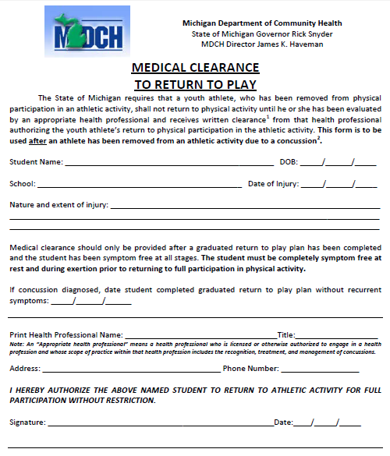
Rules
Concussions
http://www.omyfa.org
If symptoms occur at anytime seek medical attention
A clearance form is needed to return to play

Slide 13
Practice Fields

Slide 14
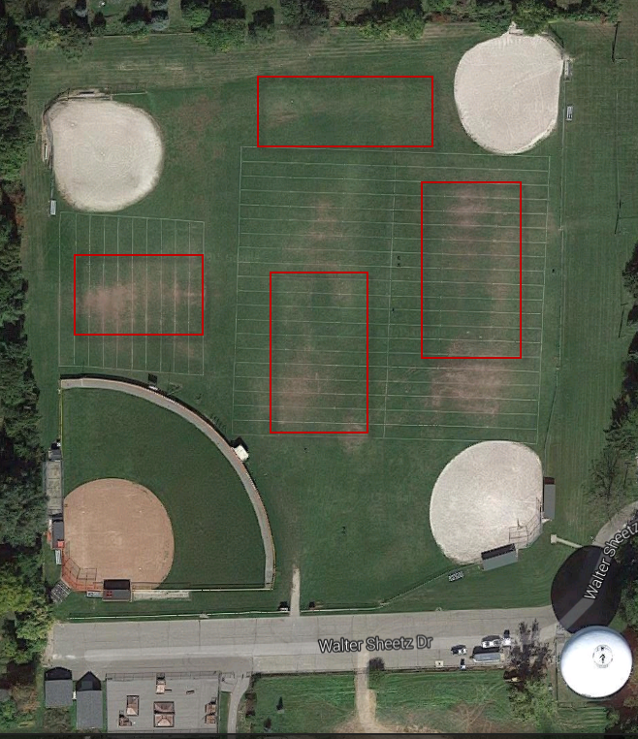
Practice Field - Football
Spectators
Flag
Var
Fresh
JV
Cheer Across @ Memorial Park

Slide 15
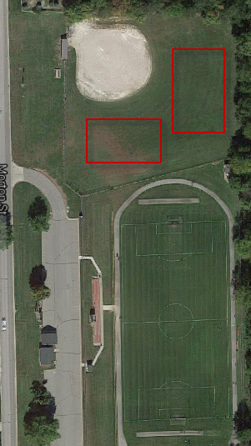
Practice Field - Cheer
Closed practice
Memorial Park

Slide 16
Home Field Games

Slide 17
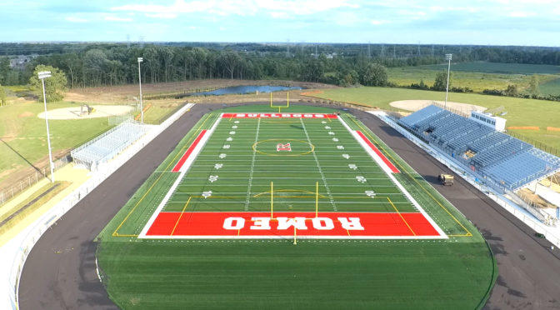
Home Field
Barnabo Field

Slide 18
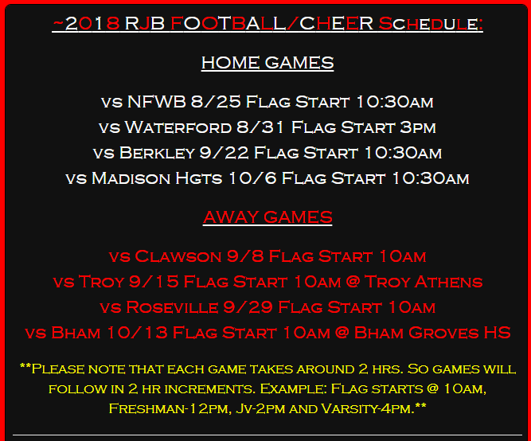
Games

Slide 19
Cheer Off & Super Bowl
Cheer off
Saturday, Nov. 3 Avondale High School
Super bowl
Sunday, Nov. 4 TBD

Slide 20
Volunteers Coordinators Heather Walker Diana Sontag

Slide 21
Volunteering is a vital
part of the RJB program. It takes about
70
volunteers to make a day of football happen, not including coaches, board members and others behind the scenes.
2018 Volunteer Requirements
4 commitments per Family
Regardless of the number of children in the program
Coaches’ families – football and cheer – are exempt from commitments. We greatly appreciate their commitment as volunteer coaches!

Slide 22
“Volunteers do not necessarily have the time; they just have the heart,”
~Elizabeth Andrew
Home Games
Four “home” games
Sept. 9th, Parent and Player Appreciation game
Pay attention to start times; all different
Full RJB schedule, times and locations on the website romeojuniorbulldogs.com

Slide 23
32.9% of parents with children under the age of 18 volunteered their time in 2014 as compared to 22.7% of people without children
Game Day Details
Access to field 30 minutes before start
Games start immediately following preceding game
All volunteers pay admission
If volunteering, be sure to sign in at the Admission table and contact your team parent to let him/her know you are here.
Parent and Player Appreciation Day – player posters; flower presentation; post game snack for players
RED Raffle Tickets – sell them or just turn them in; winners selected every home game

Slide 24
Commitments can be fulfilled by anyone on your behalf – relatives or friends. Must be at least age 18 or older. (Must be at least 18 years old to work Concessions.)
Just make sure they sign in so you get credit.
Game Day Volunteer Opportunities
Chain gang (chains on sidelines during game)
Field set up/clean up (walk around, clean-up trash in stands and in walking areas)
Announcer/Booth spotter (watch game closely and confirm with announce what to announce for plays after completion)
Opposing team spotter (watch opponent registrar to make sure all players get required plays in and out each half)
50/50 raffle ticket sales (volunteers will not be walking together, must be able to handle money and count change correctly)
Admission Ticket Sales
Concessions (Must be 18)

Slide 25
Commitments can be fulfilled by anyone on your behalf – relatives or friends. Must be at least age 18 or older. (Must be at least 18 years old to work Concessions.)
Just make sure they sign in so you get credit.
Game Day Volunteer Opportunities
Chain gang *
Field set up/clean up
Announcer/Booth spotter
Opposing Team Spotter*
50/50 raffle ticket sales
Admission Ticket Sales
Concessions
*Critical positions; must have to start a game. We may have to move volunteers around if we have to cover for “No-Shows”

Slide 26
Consider coming early to setup the field or staying late for cleanup.
That way you can enjoy an uninterrupted day of football.
Additional Volunteer Opportunities
Any of these would satisfy all three game day volunteer requirements
Football or Cheer Team Parent (Have the coach give your name as team parent to Heather or Diana)
Yearbook Photographer (Flag, Freshman, & JV still needed)
Team Registrar (JV only still needed- Must be approved by Head Coach)
Banquet Execution
Banquet is set for Wednesday, Nov. 8 at the Palazzo Grande, Shelby Twp.
If interested in any of the additional opportunities, please let Heather Walker know.

Slide 27
Please make note of your Volunteer Spot password when signing up in order to verify your commitments.
Volunteer Spot will automatically send a reminder a few days before your commitment.
Volunteer Commitment Sign Up
Volunteer Spot - www.signup.com
All RJB families will receive an invitation to sign up for commitments by Aug. 12
Families will have until Aug 24 (2 days before first game) to sign up for required 3 commitments
If sign up is not complete by Aug 24, you will be notified and your child will not be able to practice or play until three commitments have been selected
Signup.com will be used exclusively to sign up for and track commitments
To assist with tracking accuracy, please fill out the “Volunteer Details” on the site with your child’s name and team. This is how we track commitments by family.

Slide 28
“Volunteers don't get paid, not because they're worthless, but because they're priceless,”
~Sherry Anderson
“No Show/Missed” Commitment Penalty
No commitment changes/cancellations will be accepted less than a week (seven days) before a home game. A volunteer must find a replacement or be subject to the “no show/missed” commitment penalty. Please contact your team parent IMMEDIATELY if an emergency arises and you cannot make a scheduled volunteer commitment. We will work with you to the best of our ability.
If you do not show for all a scheduled commitment, the RJB will charge you $150. You can earn your money back when you complete your volunteer commitments in full for the season. Your athlete will NOT be able to participate in practice or play in games until the $150 is paid. No exceptions. This rule will be strictly enforced.

Slide 29
We’re looking forward to a great season of RJB football. Thank you in advance for your dedication to our kids.
GO DOGS!
If you have any questions about volunteering, don’t wait until the end of the season. Talk to us now!
Heather Walker
586.419.6561 cell
text or call please
Diana Sontag
586.944.6057 cell
text or call please

Slide 30
Wrap up

Slide 31
Wrap up
Severe weather we will take shelter in the Park & Rec building.
Heat index over 104 ͦ practice will be stopped

Slide 32
Wrap up
Raffle tickets can be dropped off at the shed or at the admissions ticket table and drawings will be held during home games; winners will be announced during the JV home games and posted on the website.
Please be ready to pick your athletes up 20 minutes prior to practice ending
Have plenty of water for your child on practice and game days
Any equipment adjustments made before or after practice at the shed
24 hr period “cool off” period

Slide 33
Sportsmanship
PLEASE REMEMBER
These are kids
This is a game
Parents should cheer for everyone (football & cheer)
Applaud for opposing cheer team
The Referees are human
NO AIR HORNS
Please don’t put us in a predicament to have to remove you from a game

Slide 34
Wrap up
Apparel Store Closed…
Replica Jersey site Closed
Fire sale of old spirit wear this week at parent meetings
?

Slide 35
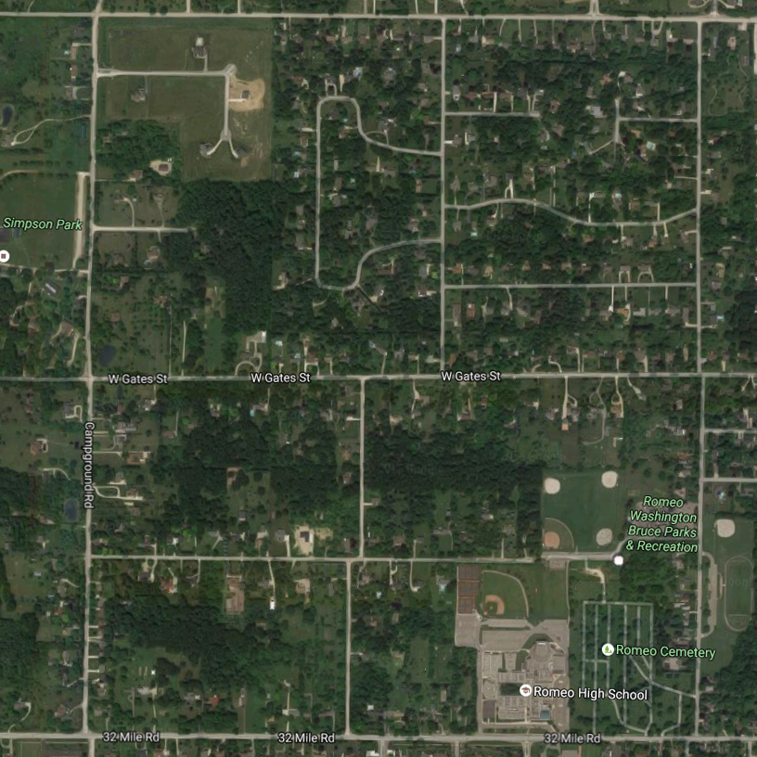
Romeo Jr. Bulldogs
During practice
6:15 at the shed
Running Club
Route
Miles
1.0
1.5
4.1

Slide 36
Questions

