Slide 1
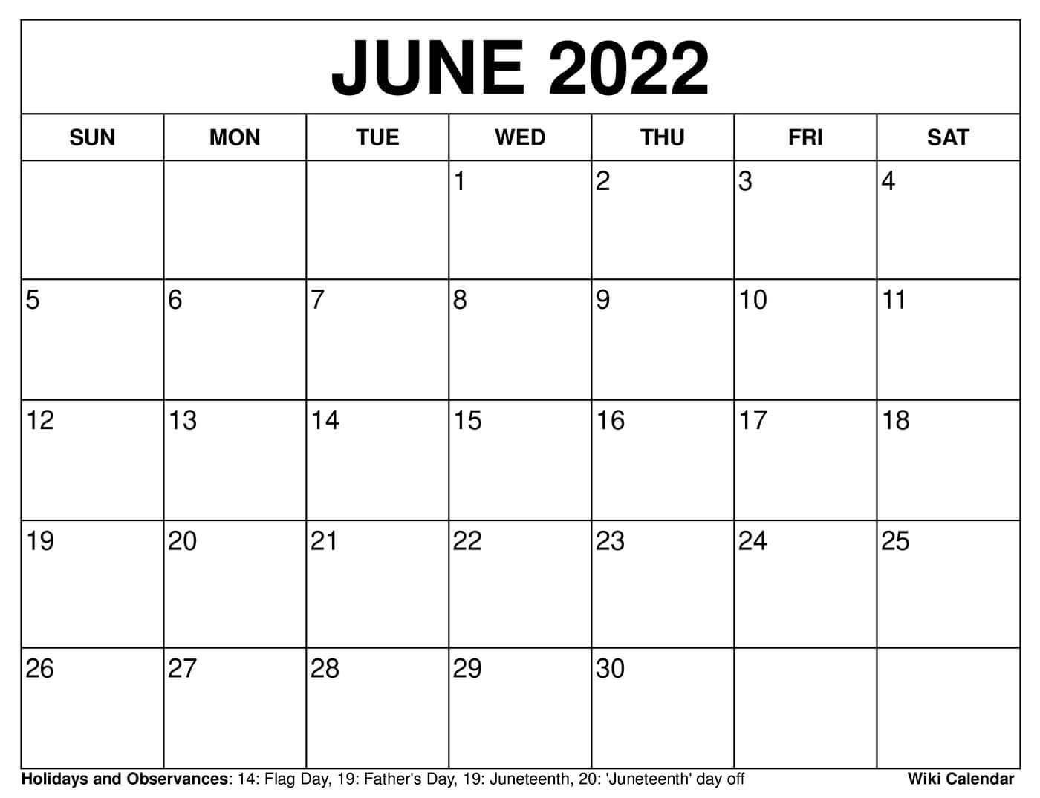
CLUB TRYOUTS
Girls College Showcase camp

Slide 2
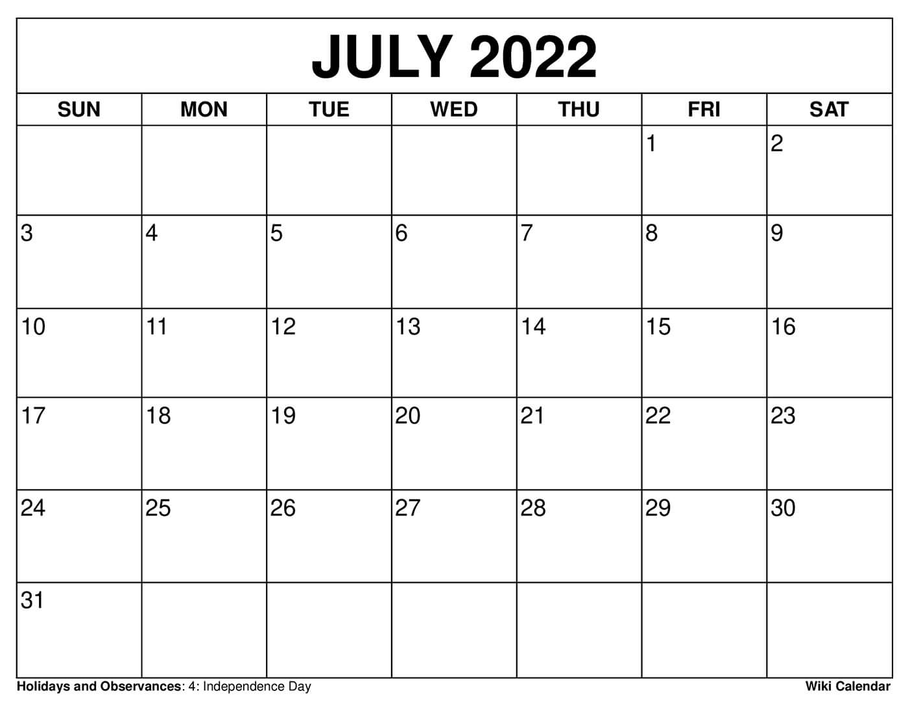
BVSW TEAM CAMP GIRLS 4:30-6:30 BOYS 6:30-8:30

